Slide 1
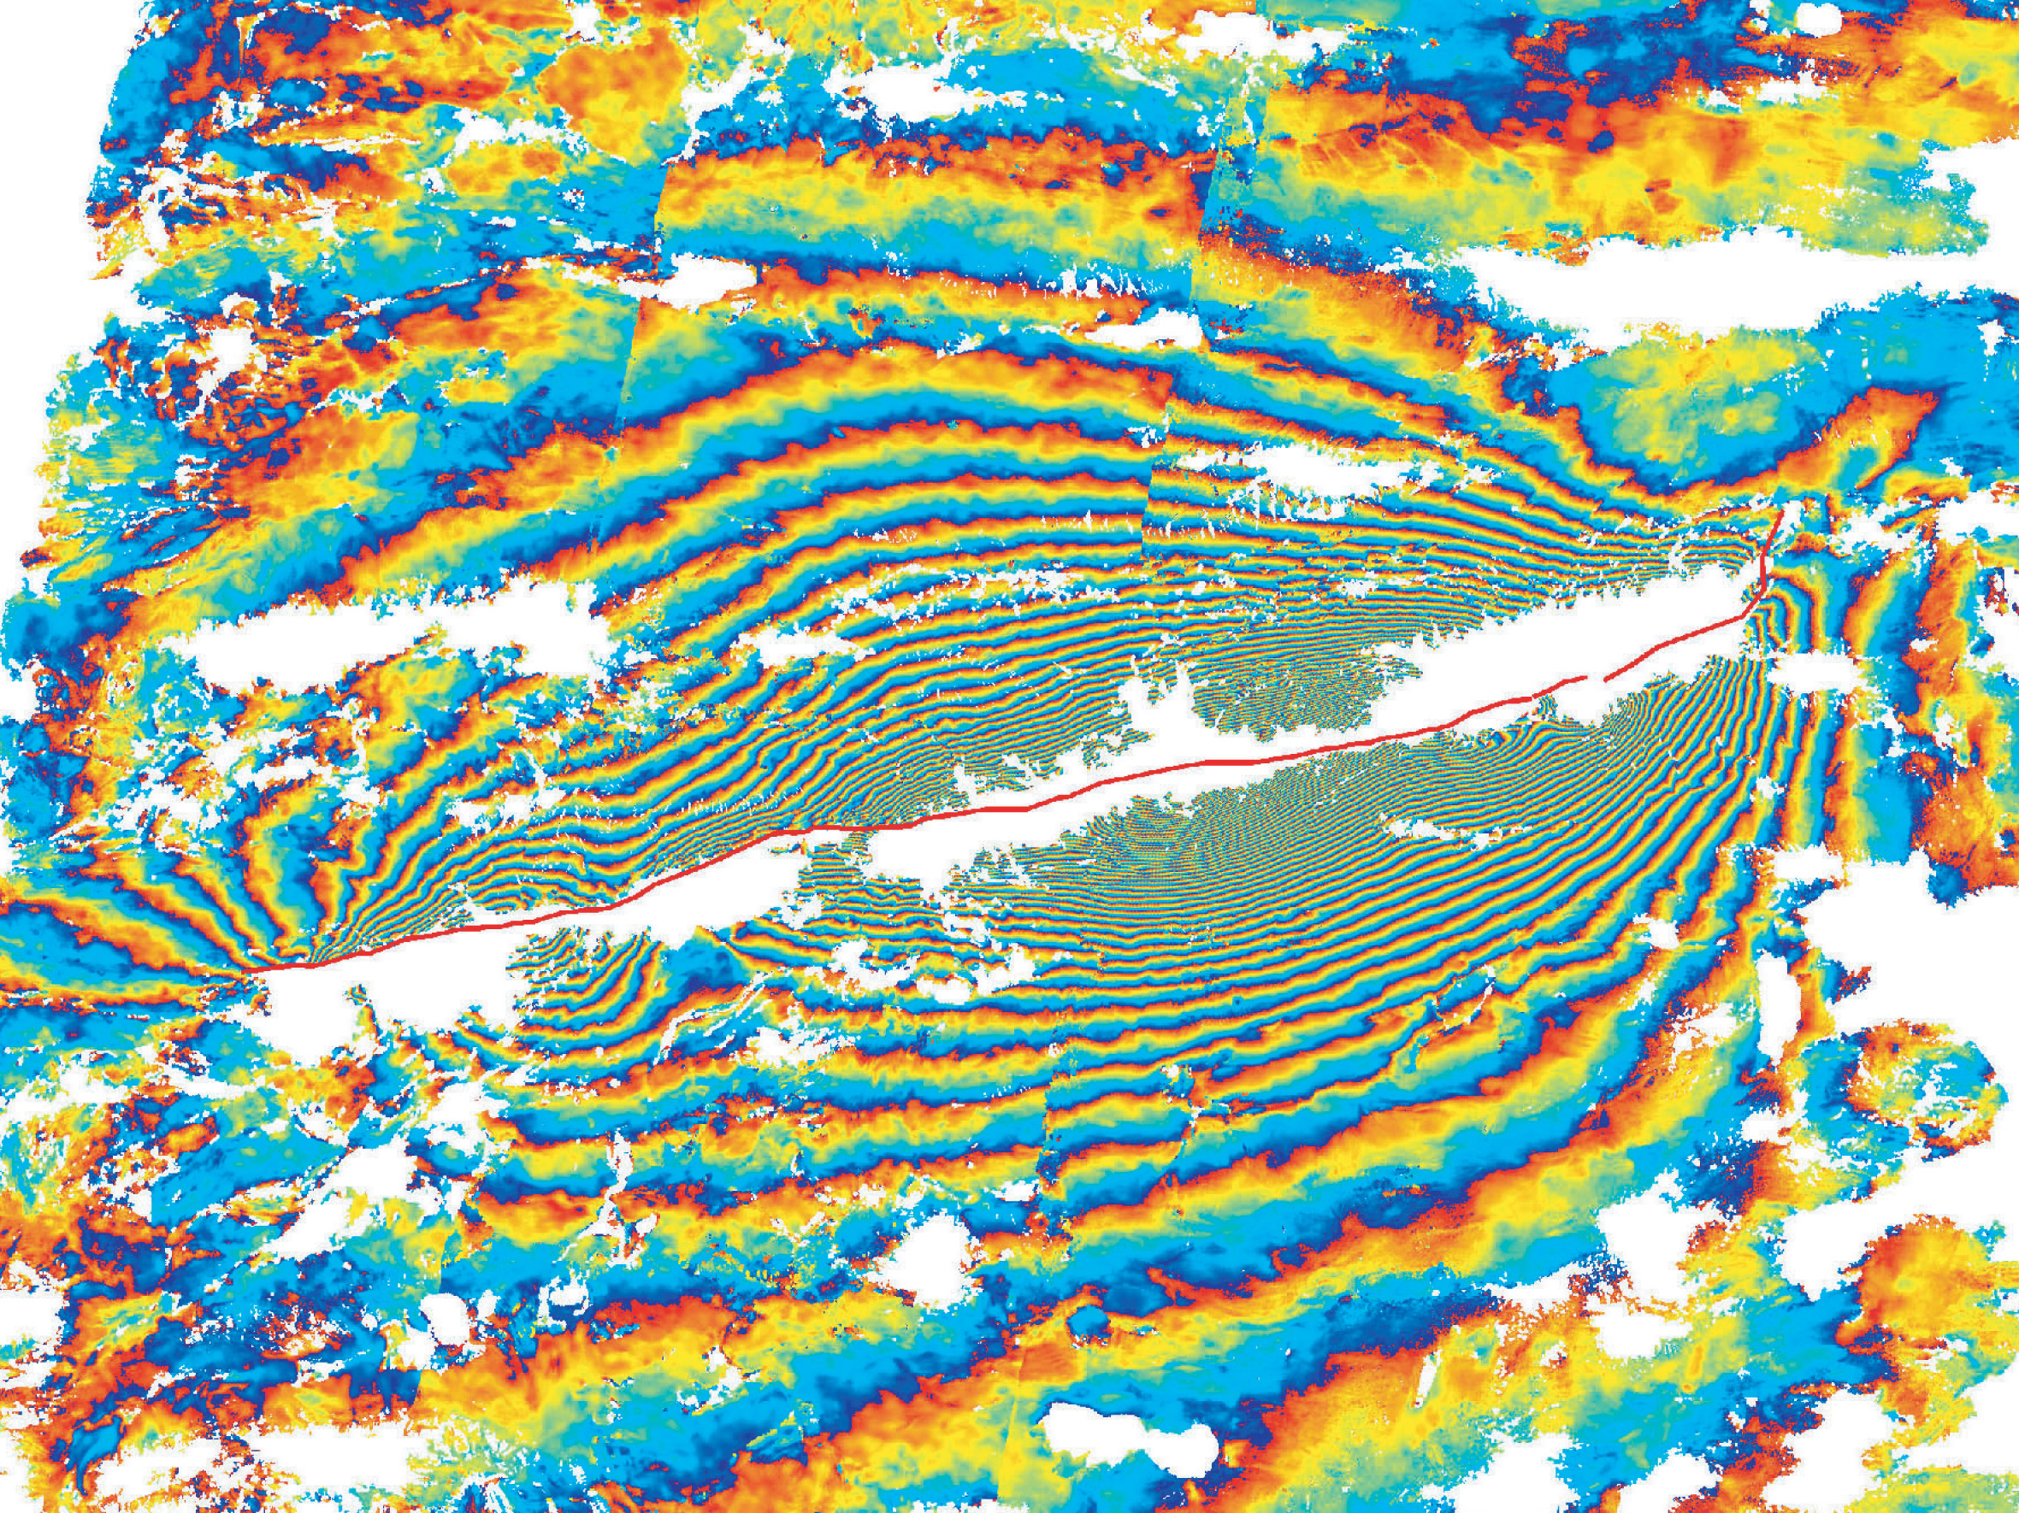


How does InSAR work?
Modified from slides by Gareth Funning (UC Riverside) and the 2022 UNAVCO ISCE short course
Notes:
This is designed as a read-it-yourself guide to the basics of InSAR, a technique that can be used to image the movement of Earth’s surface at high resolution.

Slide 2
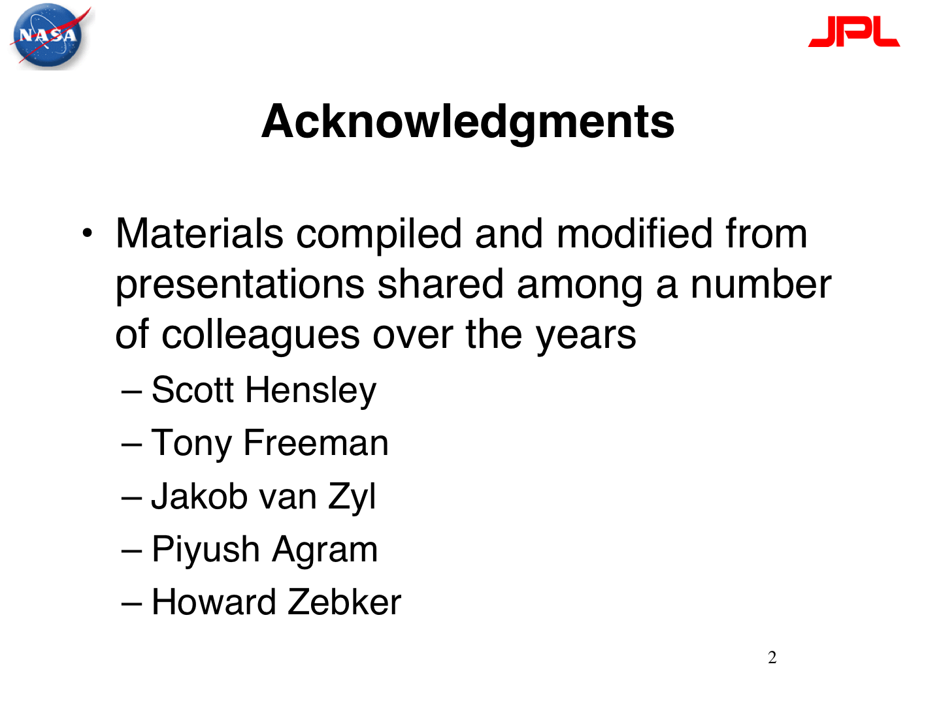

Slide 3
Outline for the next three lectures
Basics of SAR (today) and InSAR (today and next time)
Limitations (next time)
Application to earthquakes and other examples (Nov 15/16; Dr. Maurer traveling Nov 8/9)

Slide 4
InSAR
Interferometric
Synthetic
Aperture
Radar
use wave interference
pretend you have a big radar antenna
emit microwaves, measure echoes
Notes:
SAR (Synthetic Aperture Radar) is an imaging technique in its own right that uses the amplitude (intensity) of backscattered radar from the ground as a means of imaging it. A single image acquisition is all that is needed to produce a SAR image. Typically we do not use the phase of a single SAR image for imaging purposes.
On the other hand, we can use the phases of multiple SAR images. InSAR is a method that uses two or more SAR images to measure movements of Earth’s surface, by calculating the interference between the phases of the SAR images.

Slide 5
Synthetic aPerture RADAR (SAR) Theory
Interferometric Synthetic Aperture Radar

Slide 6
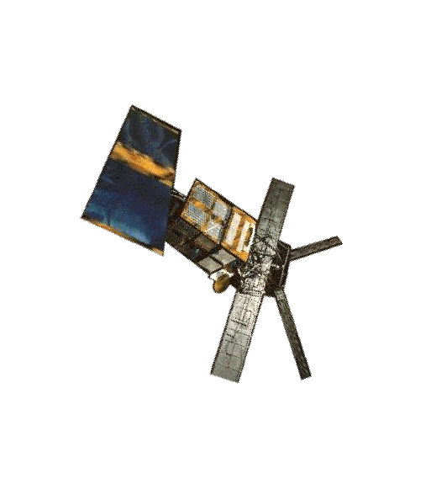
SAR: how it works
Satellite emits radar pulse
Radar is backscattered
Amplitude and phase of echo recorded at the satellite
Notes:
The radar antenna on a satellite (shown here is ERS-1, the first long-lived orbiting SAR satellite, launched in 1991) is both an emitter of radar and a detector of radar. A pulse of microwave radiation is emitted toward the ground, and some of it is scattered back to the satellite.The antenna records both the amplitude (intensity) and phase of the backscattered radar. A typical radar satellite makes over a thousand such measurements every second (in the case of ERS-1, 1680 measurements per second).

Slide 7
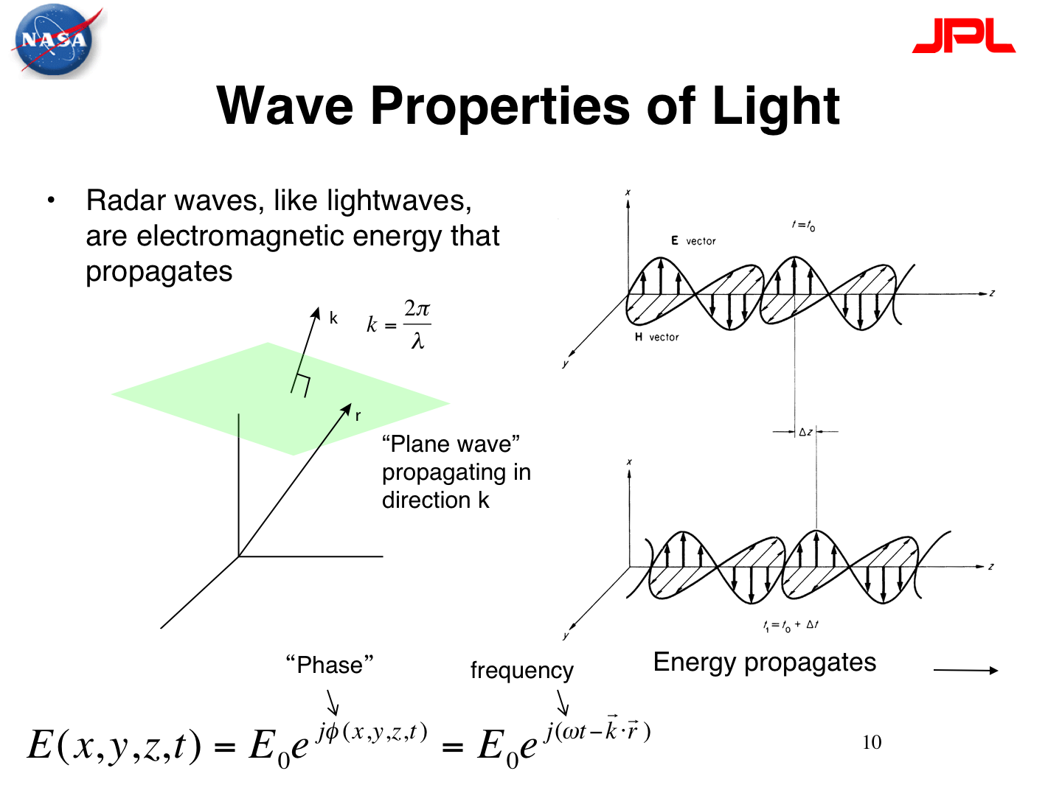

Slide 8
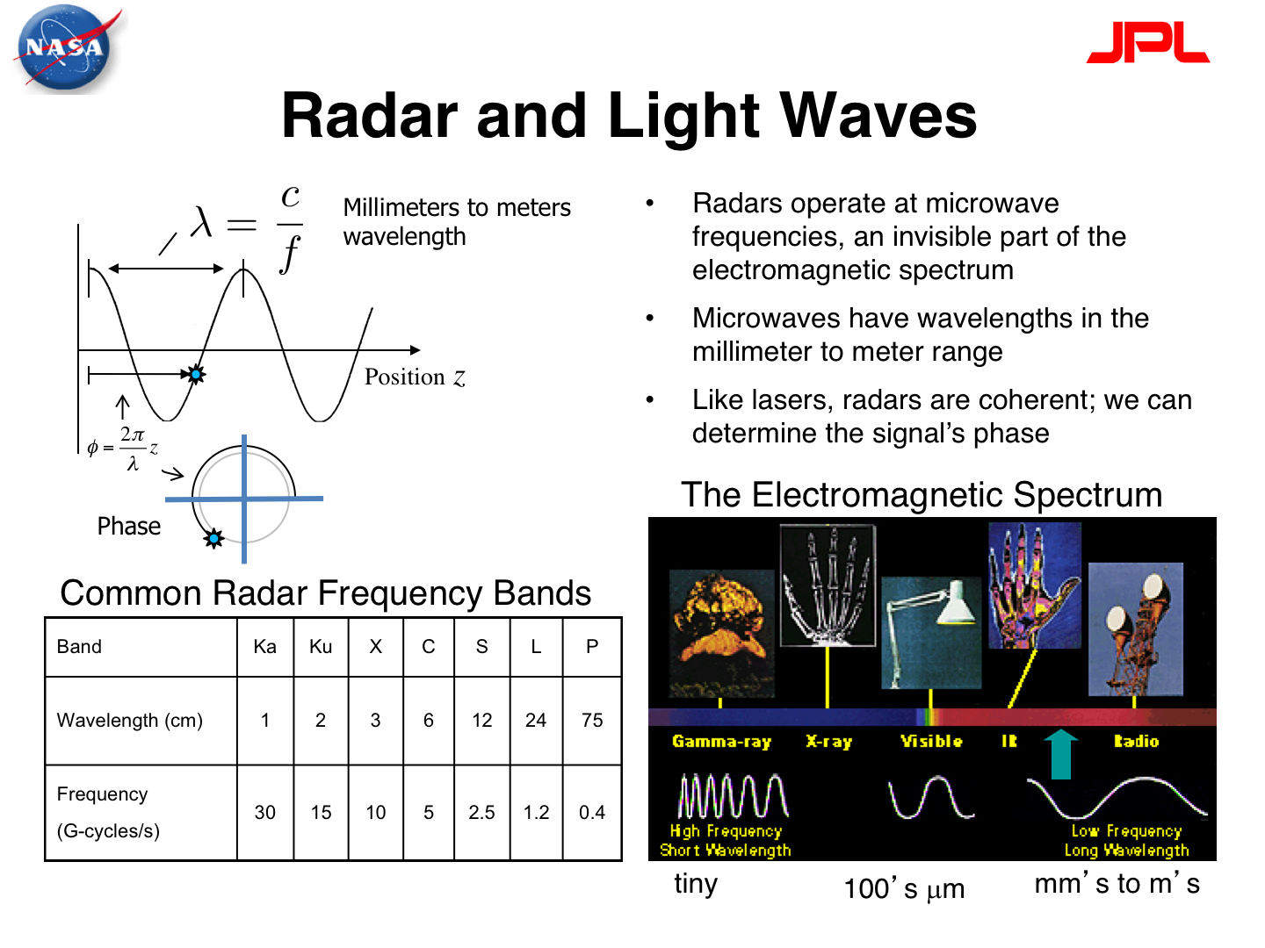

Slide 9
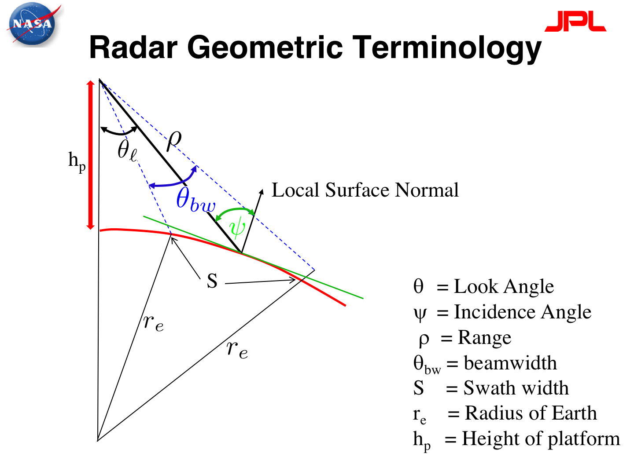

Slide 10
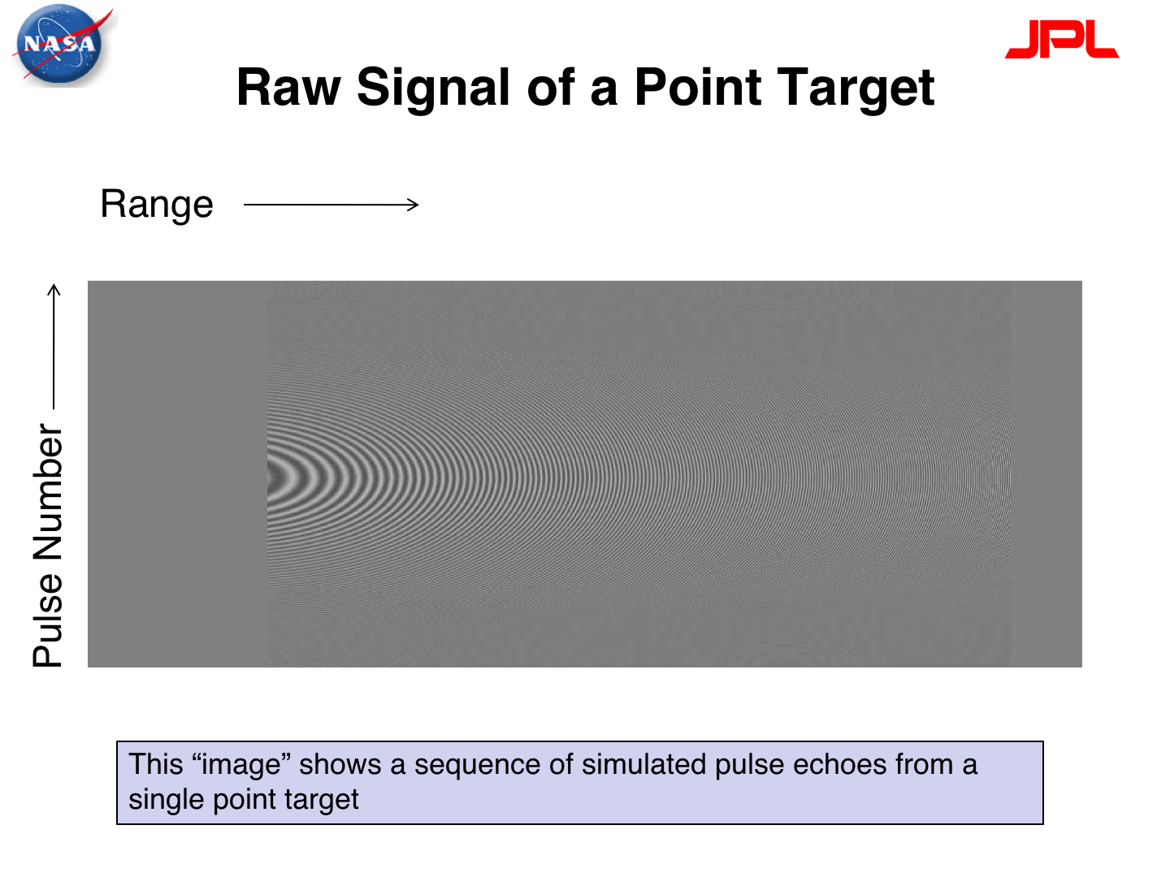

Slide 11
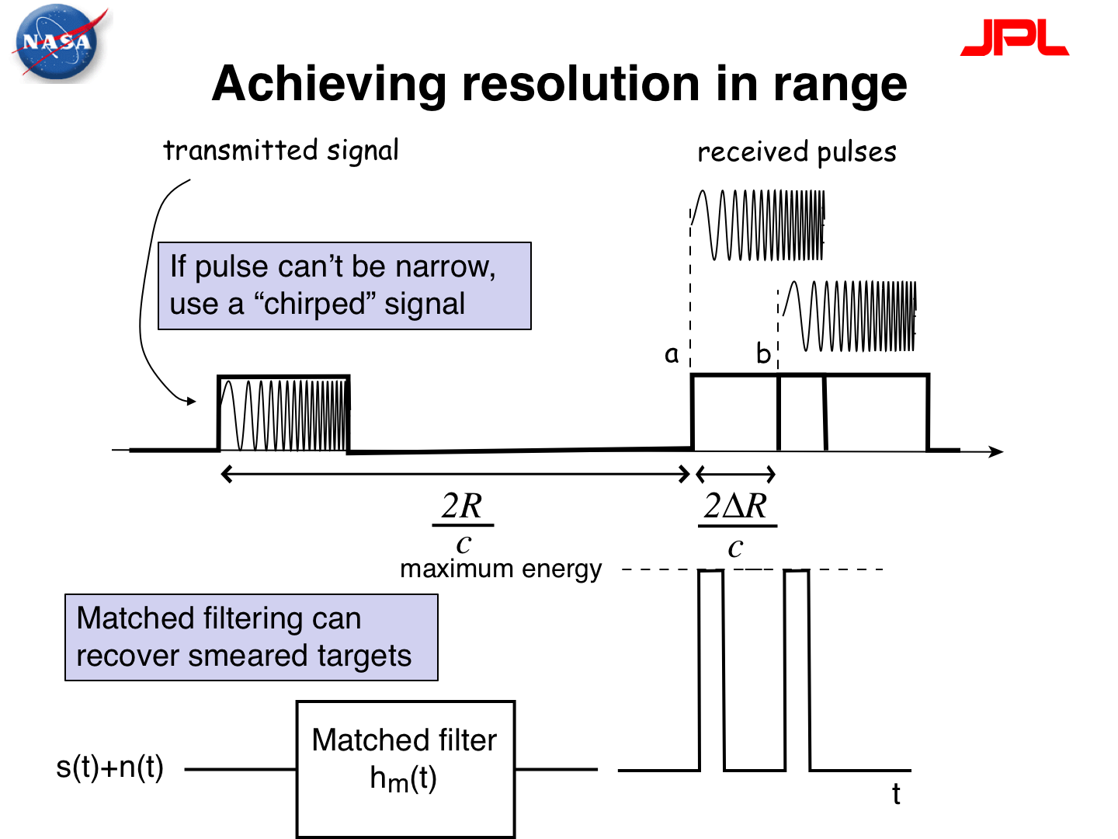

Slide 12
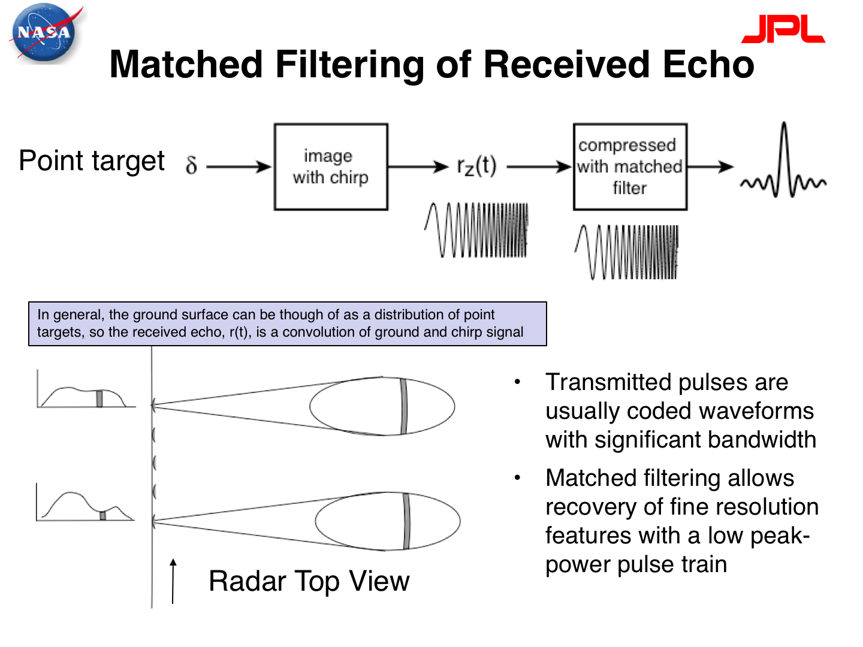

Slide 13
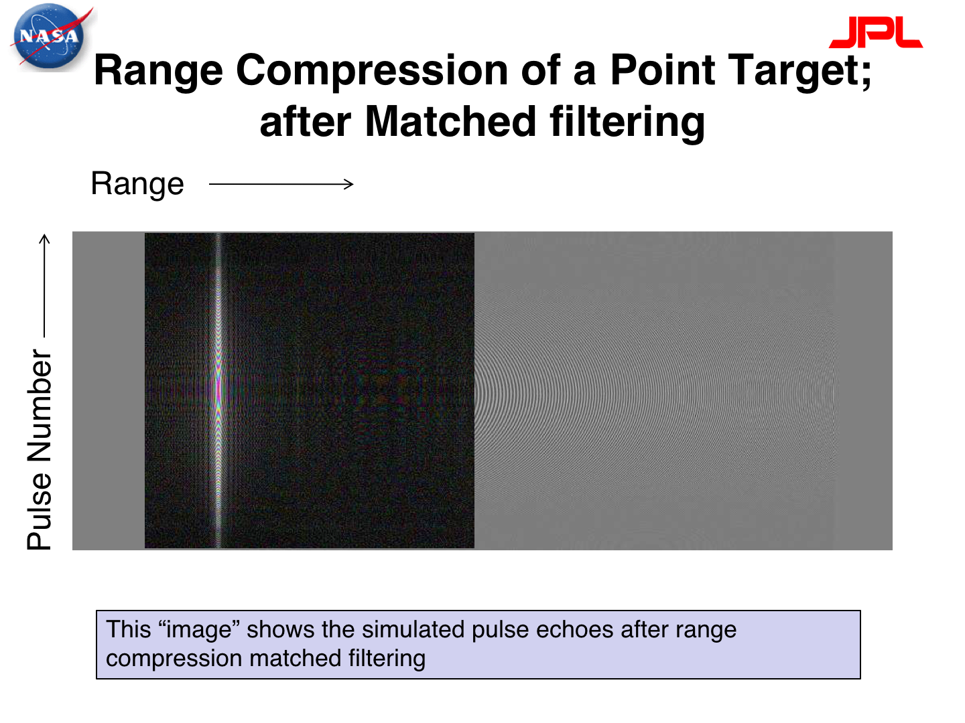

Slide 14
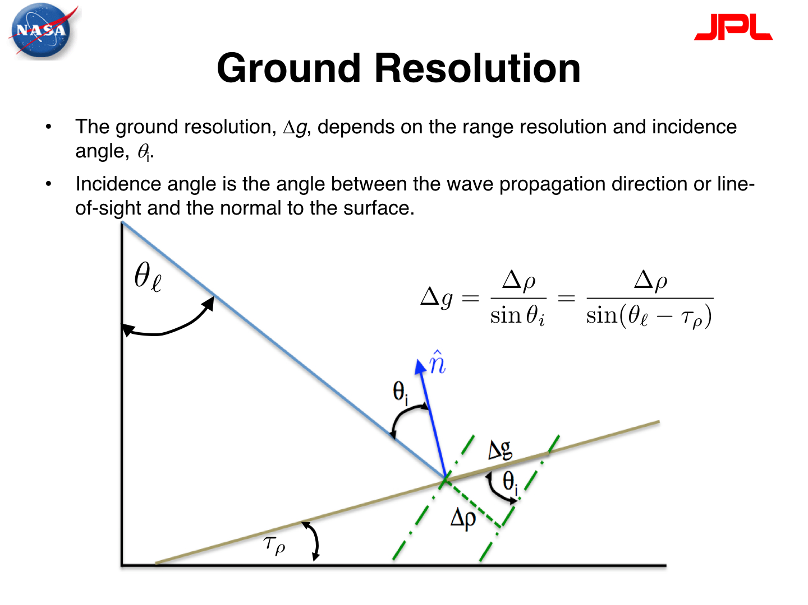

$$ψ$$

Slide 15
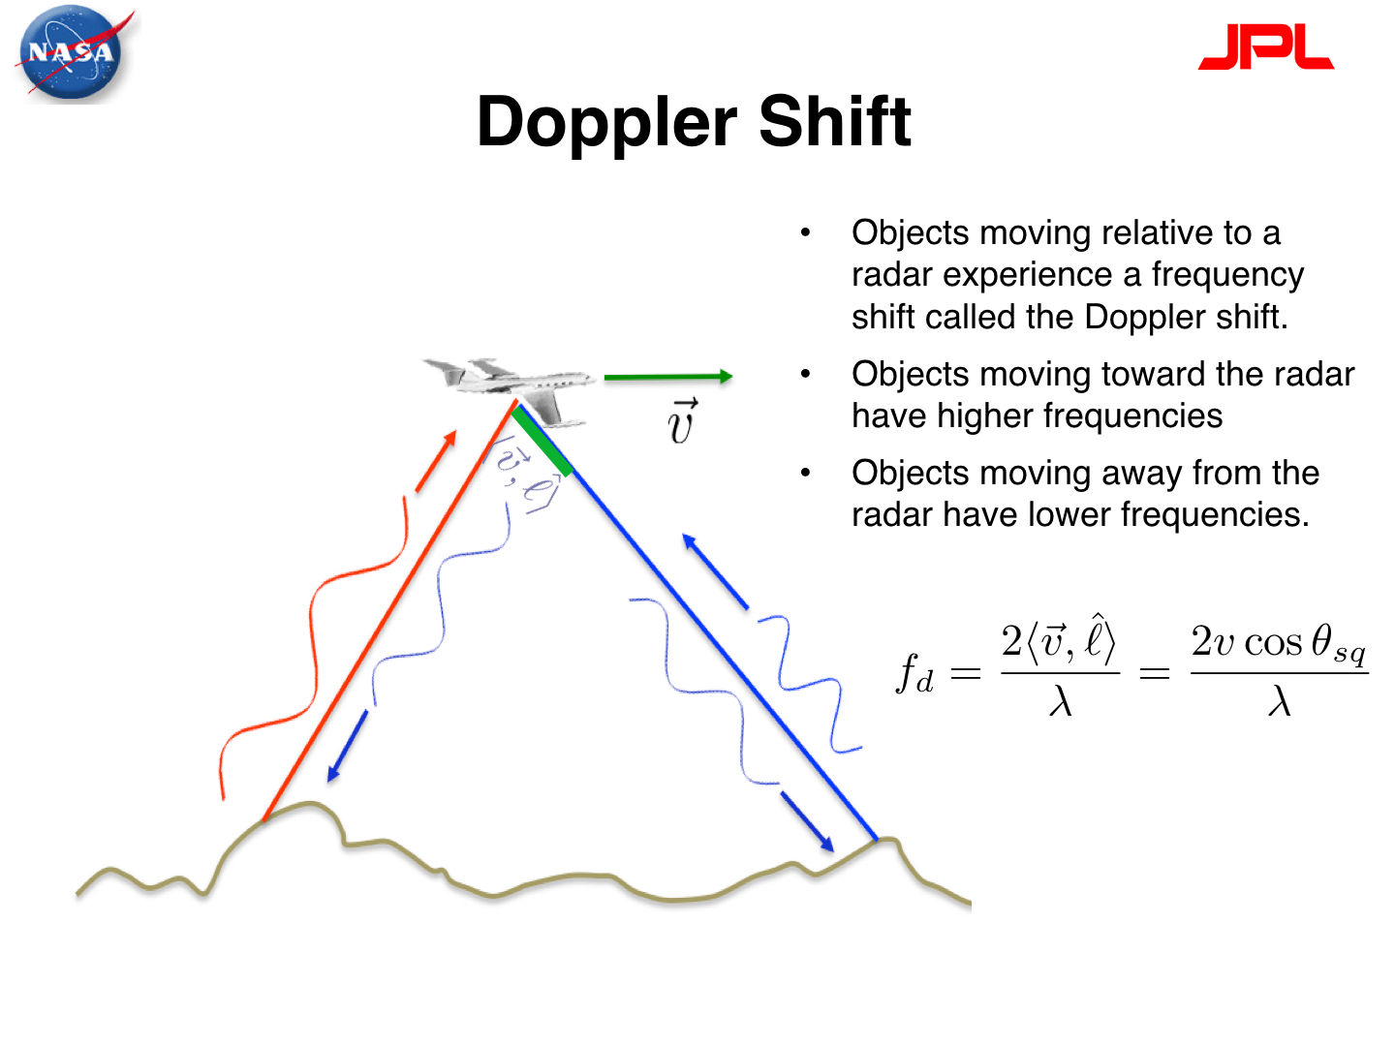

Slide 16
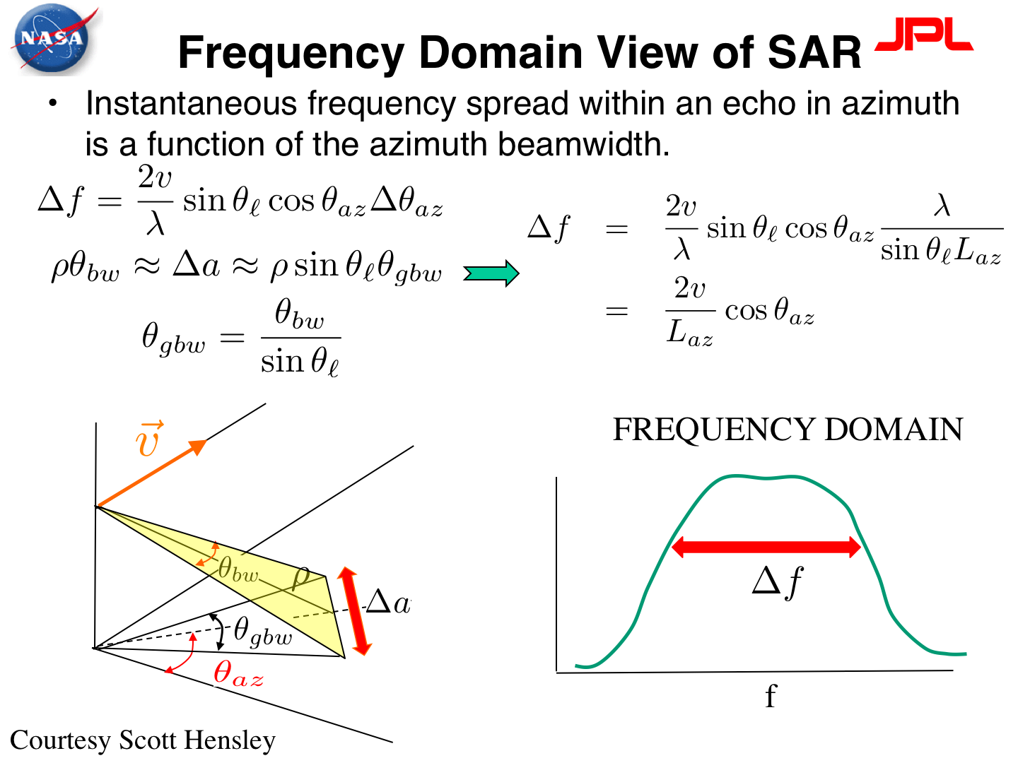

Slide 17
flight direction
ground swath
5 km
Notes:
The radar antenna is mounted on the right side of the satellite (in SAR-speak, we say that the radar “looks to the right”). The idea behind this is that we can know for certain which direction any backscattered radar is coming from (which would not be possible if the radar was pointing vertically down).
Also, note that there is an inverse relationship between the resolving power of a radar antenna and its length (its “aperture” in radar-speak). A antenna with a 10 m aperture (a typical radar antenna length for several past missions) has resolution of a few kilometers on the ground. Conversely, you would need an antenna with an aperture of several kilometers to image something on the scale of a few tens of meters on the ground—and it would not be feasible to launch or power such a thing in orbit! Luckily, radar engineers are clever …

Slide 18
flight direction
ground swath
Notes:
…and it was recognized that a single point on the surface is repeatedly observed as the satellite flies over the ground.

Slide 19
flight direction
synthetic aperture
(5 km instead of 10 m!)
ground swath
resolution 20 m instead of 5 km!
Notes:
When we process the data, we can integrate all the images that would have covered the same point on the ground to effectively pretend that the radar antenna had an aperture of several kilometers length. This “synthetic aperture” idea is what allows us to make high-resolution images of the ground using satellite-borne radar.

Slide 20
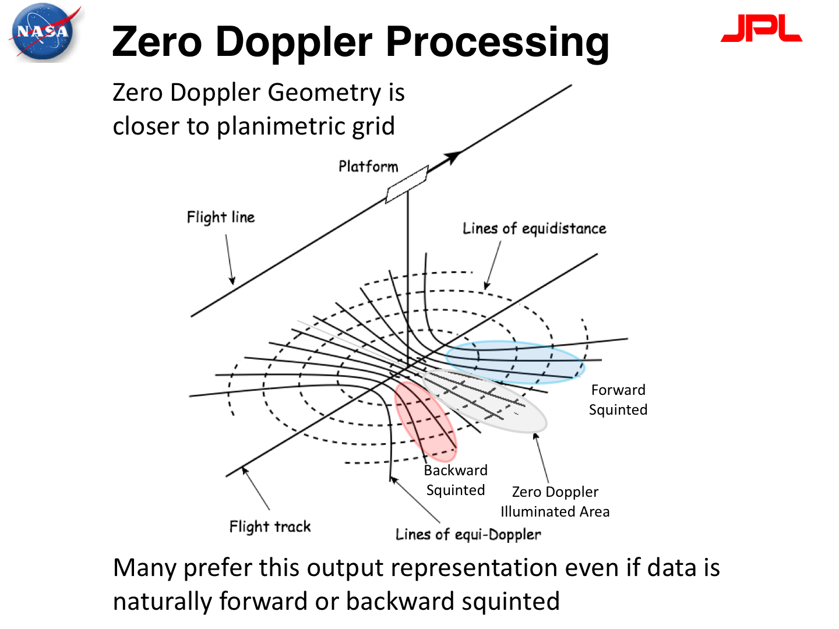

Slide 21
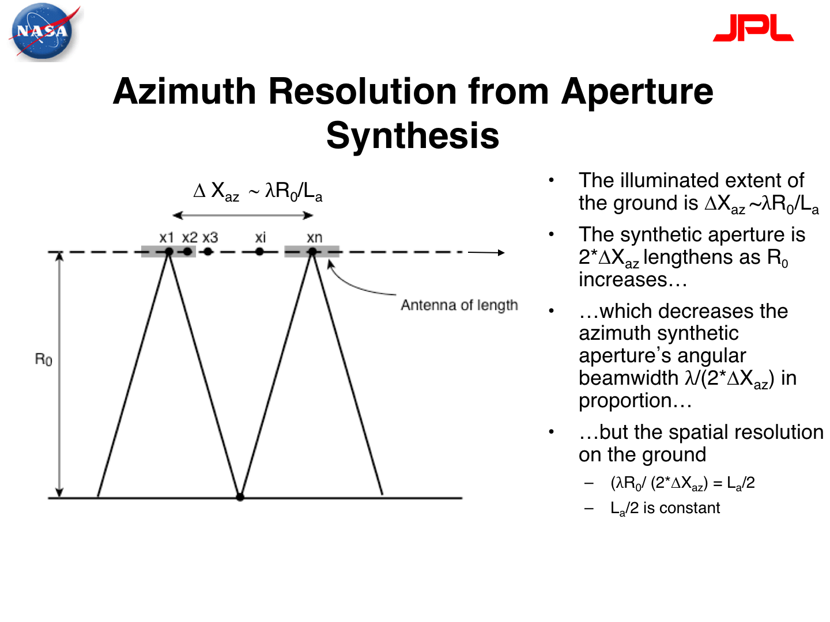

Slide 22
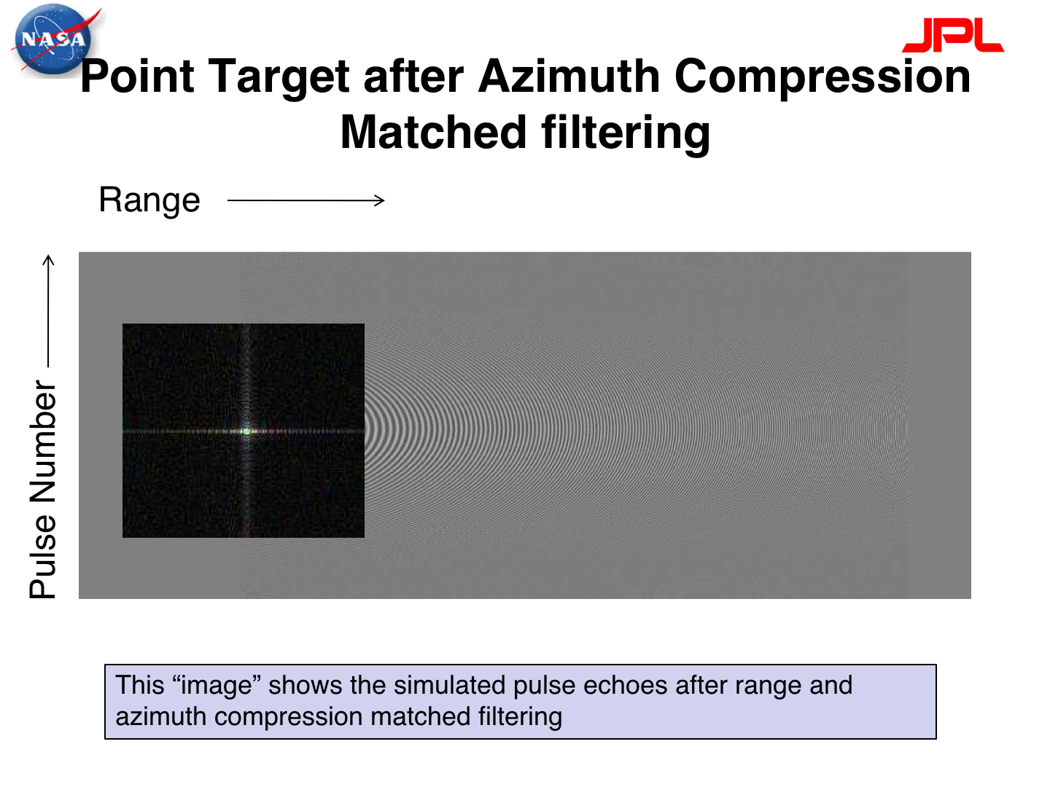

Slide 23
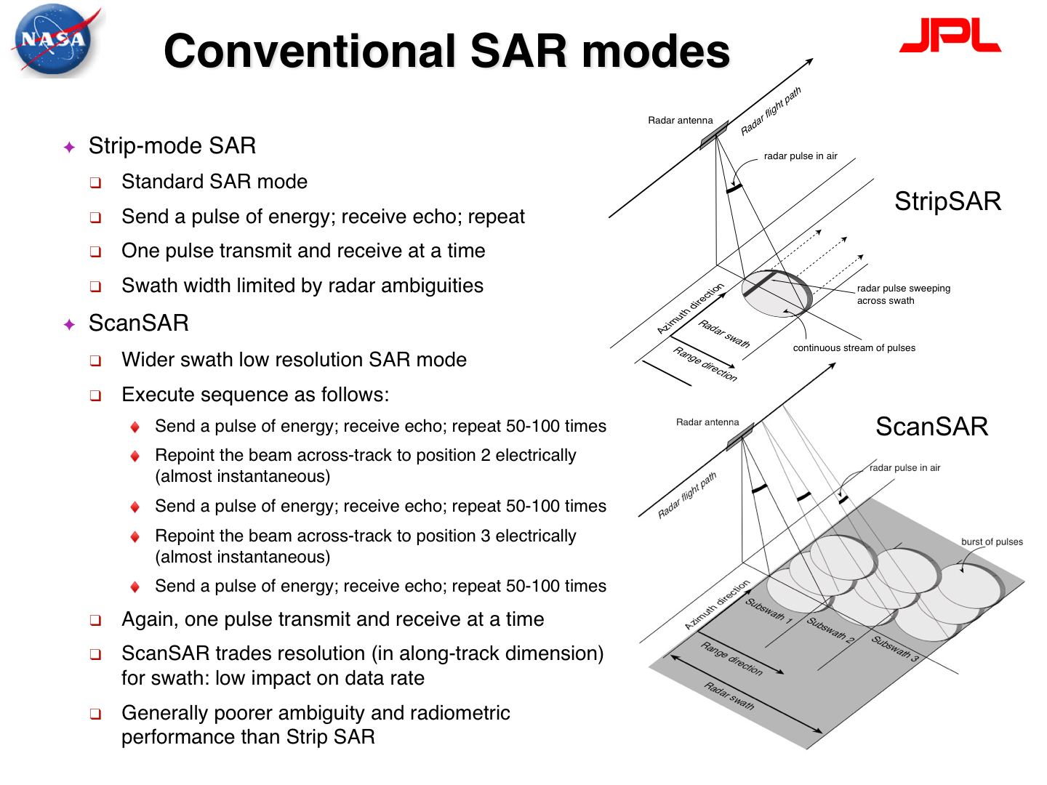

Slide 24
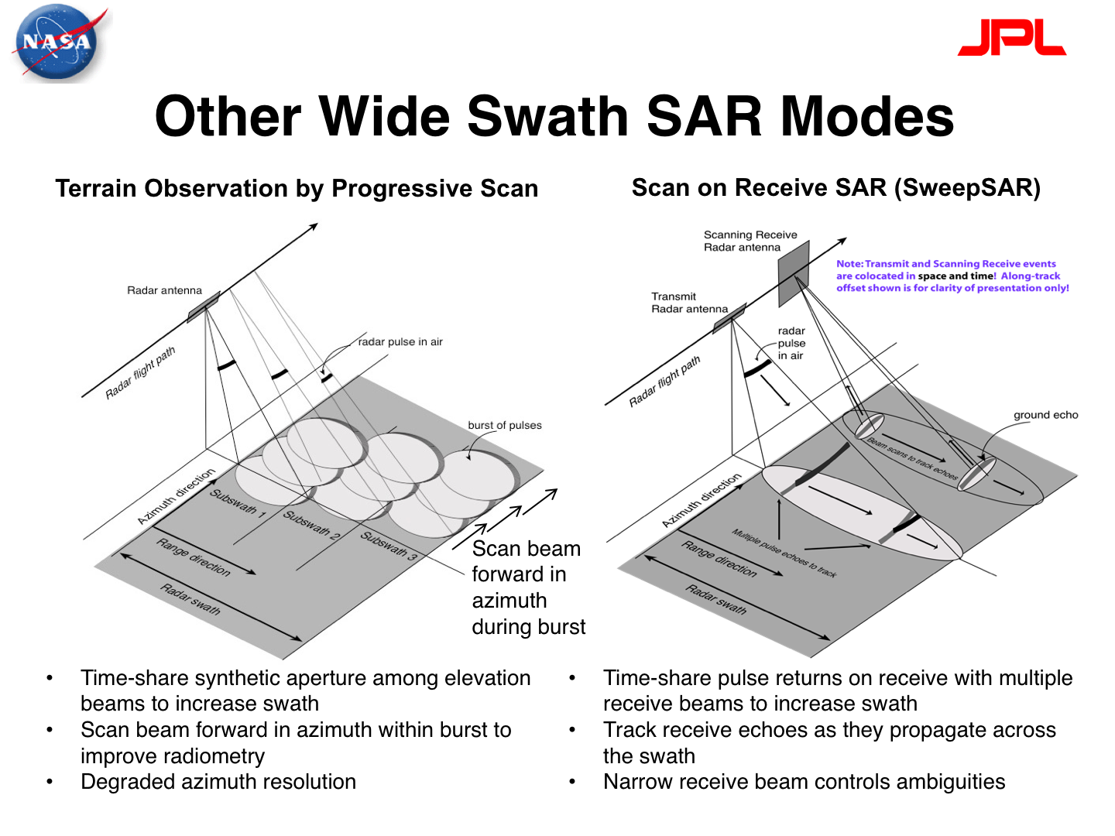

Slide 25
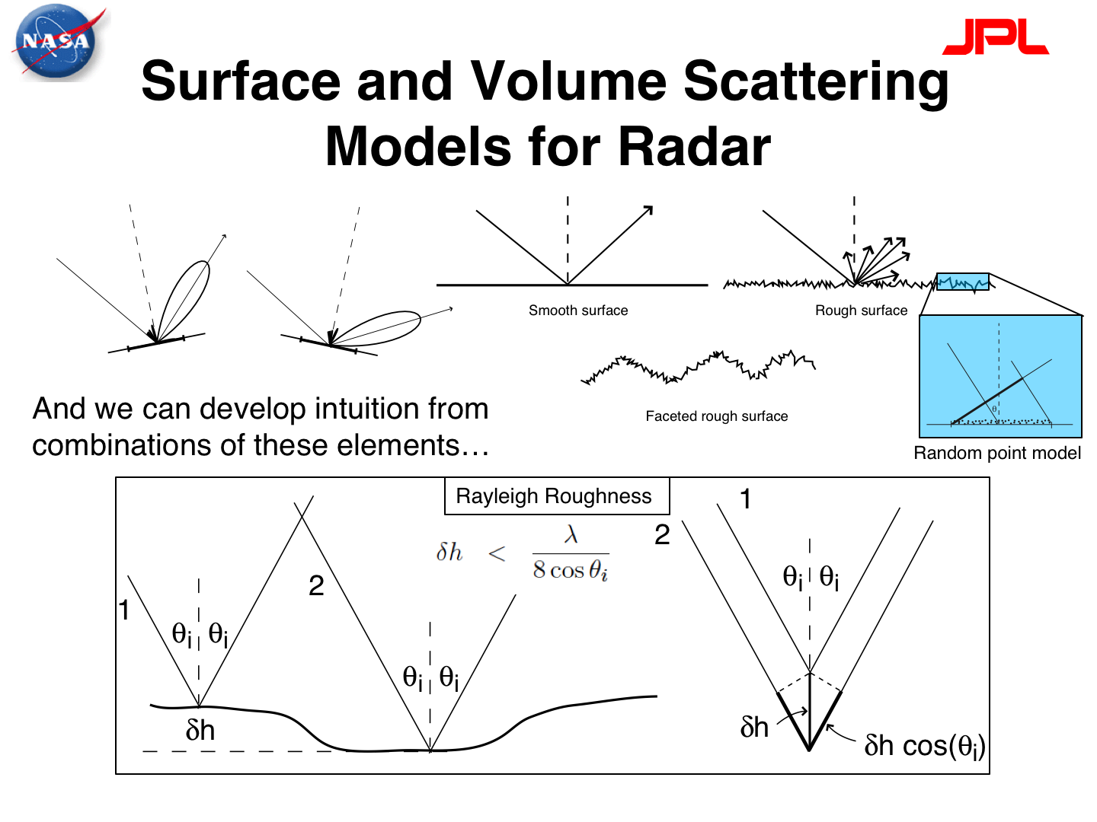

Slide 26
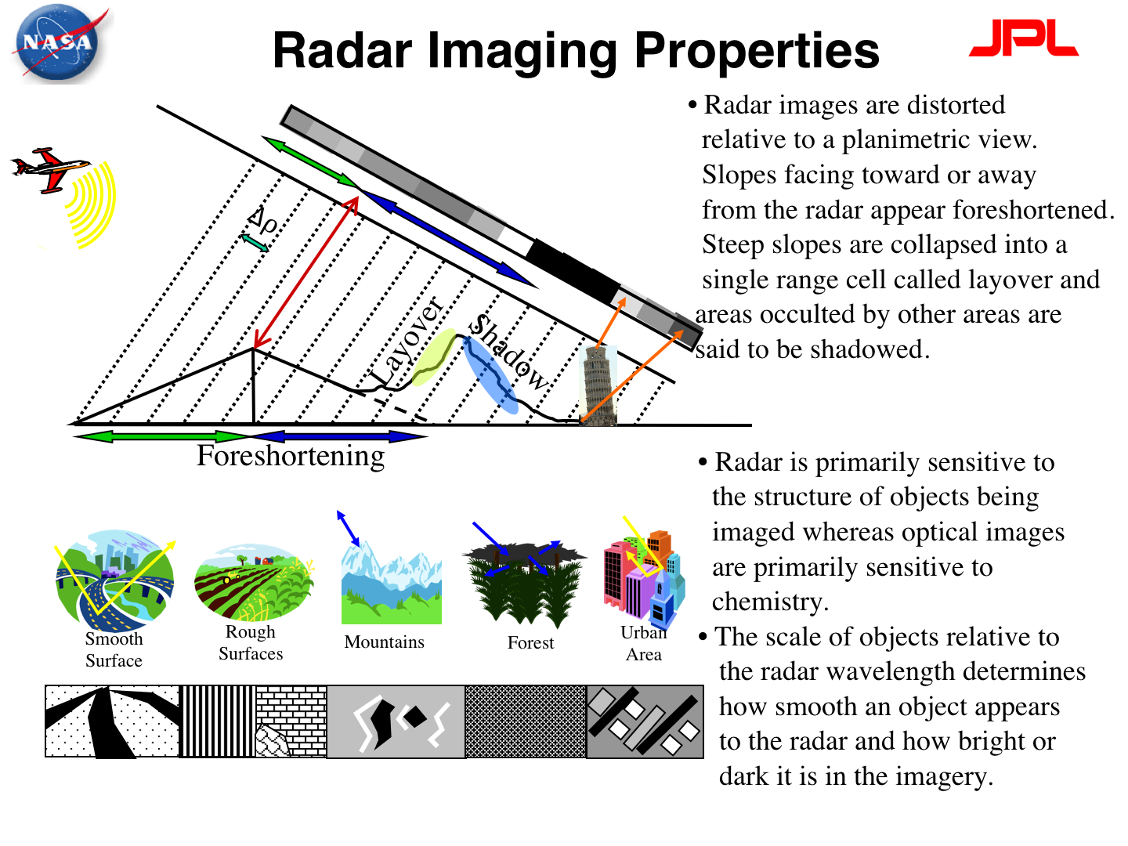

Slide 27
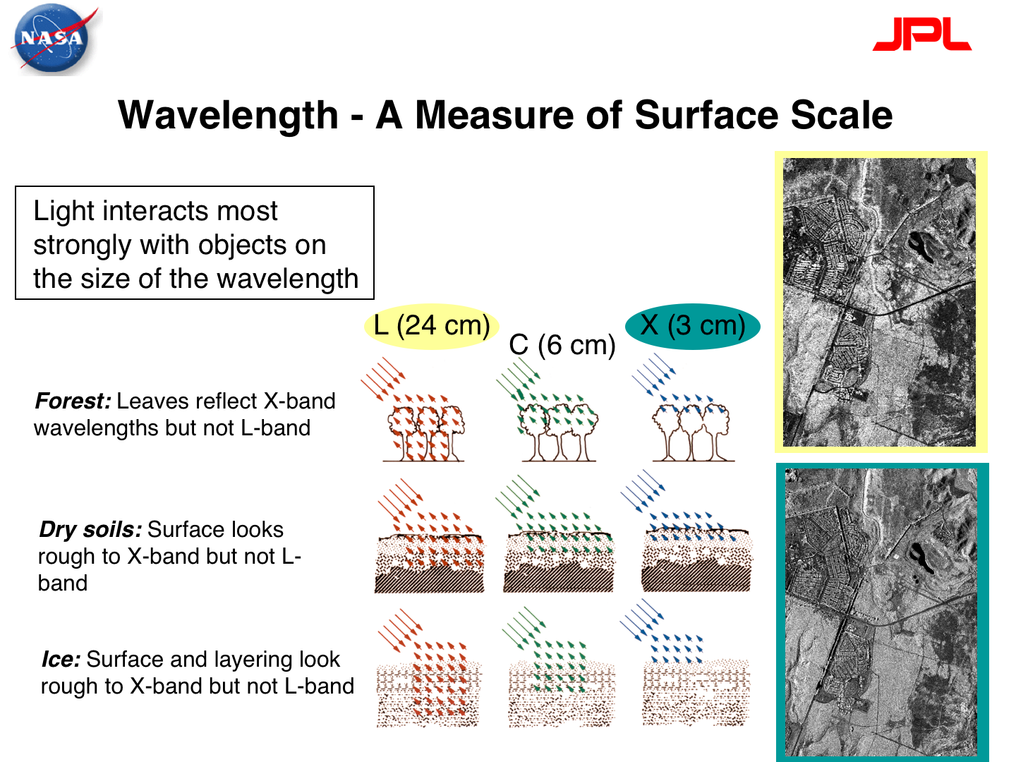

Slide 28
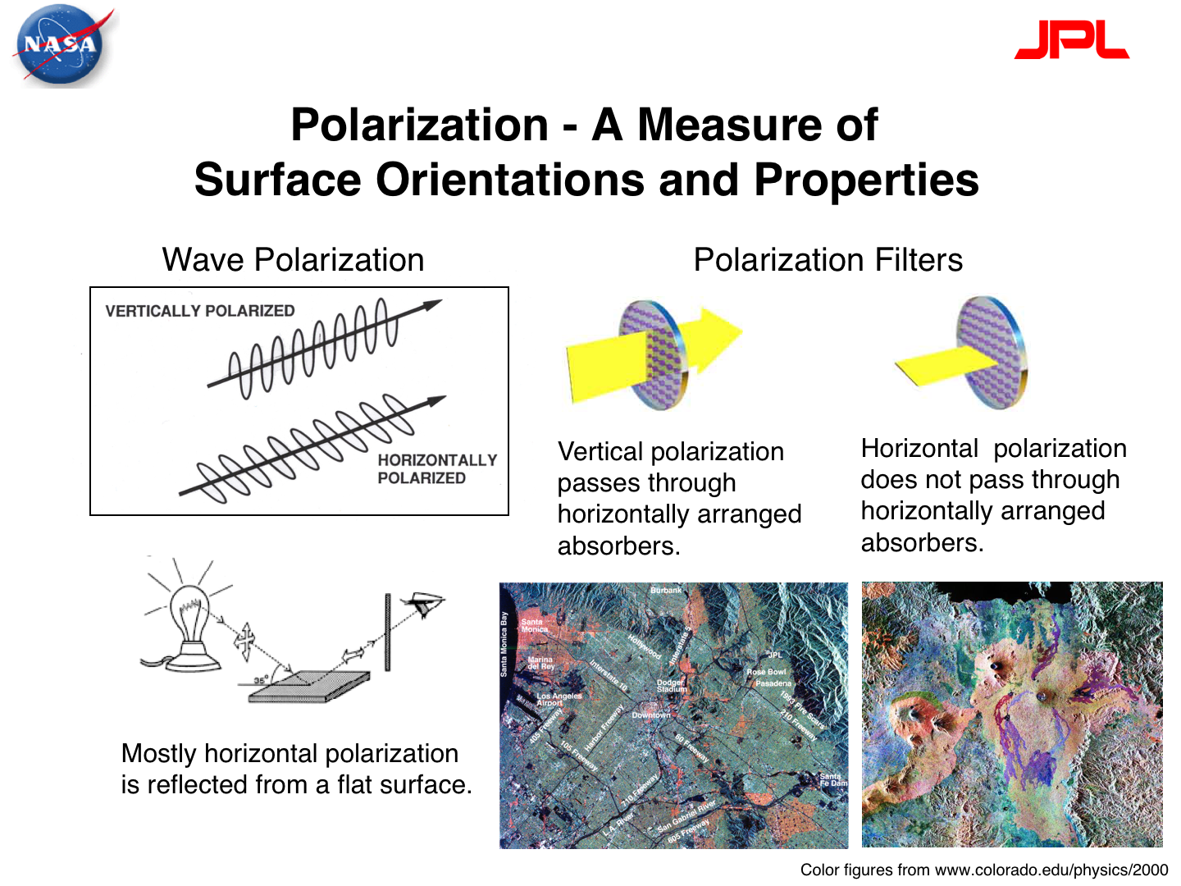

Slide 29
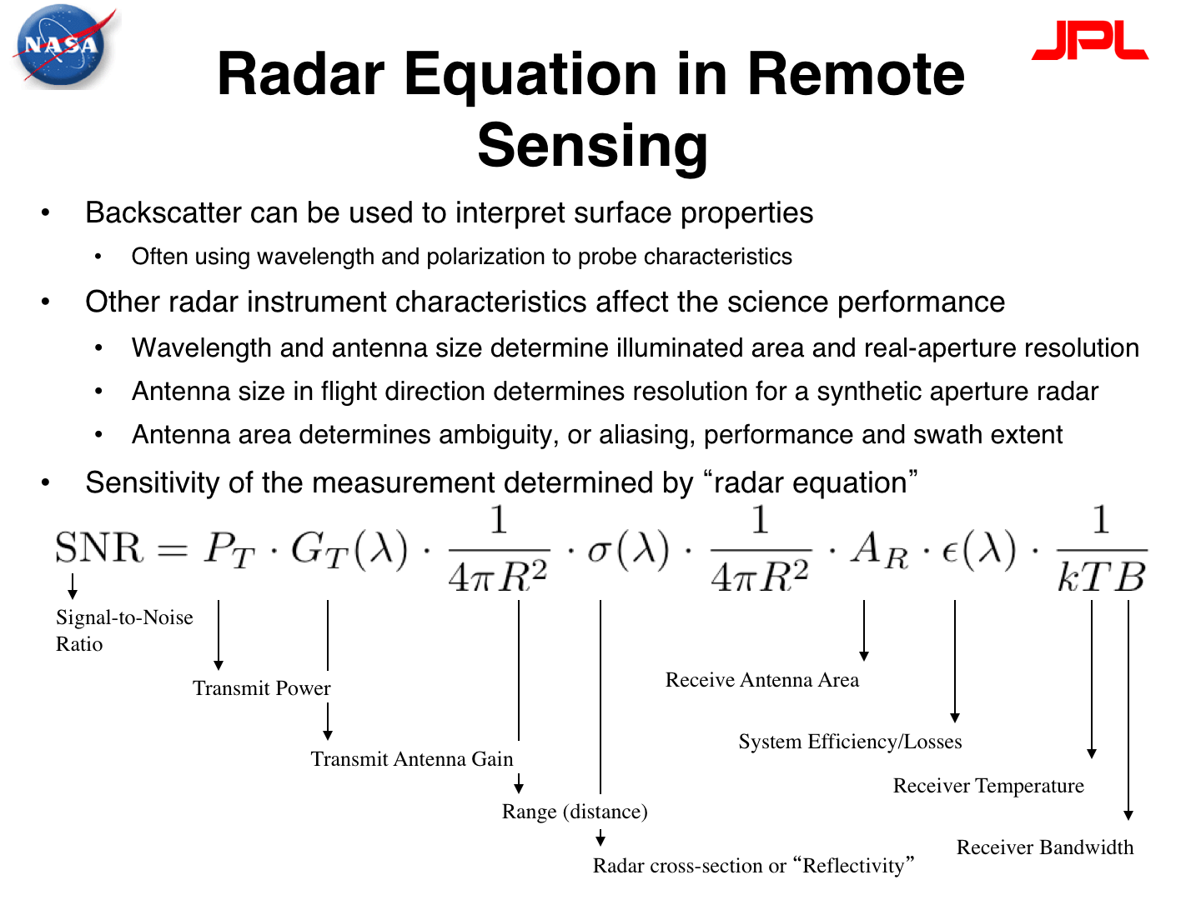

Slide 30
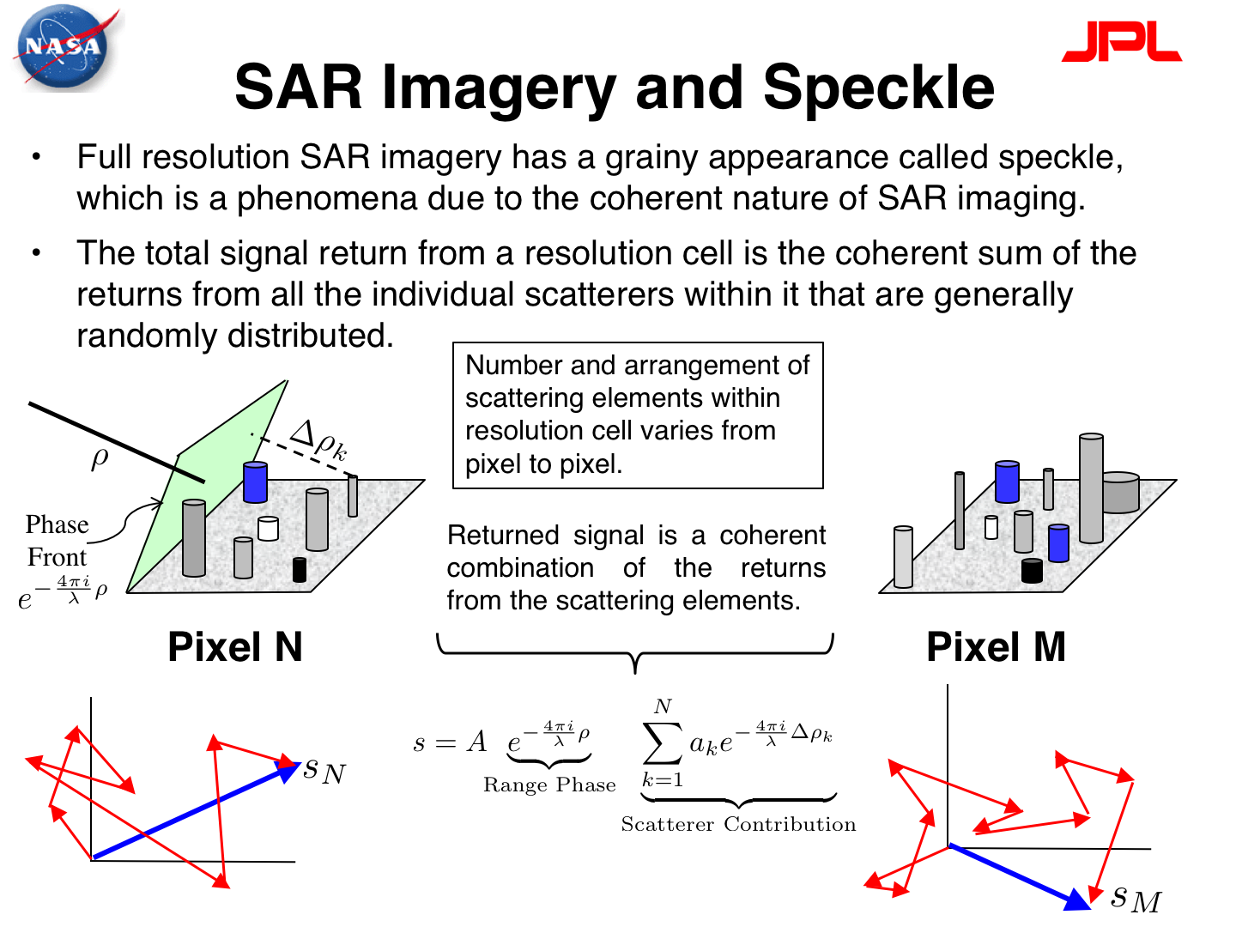

Slide 31
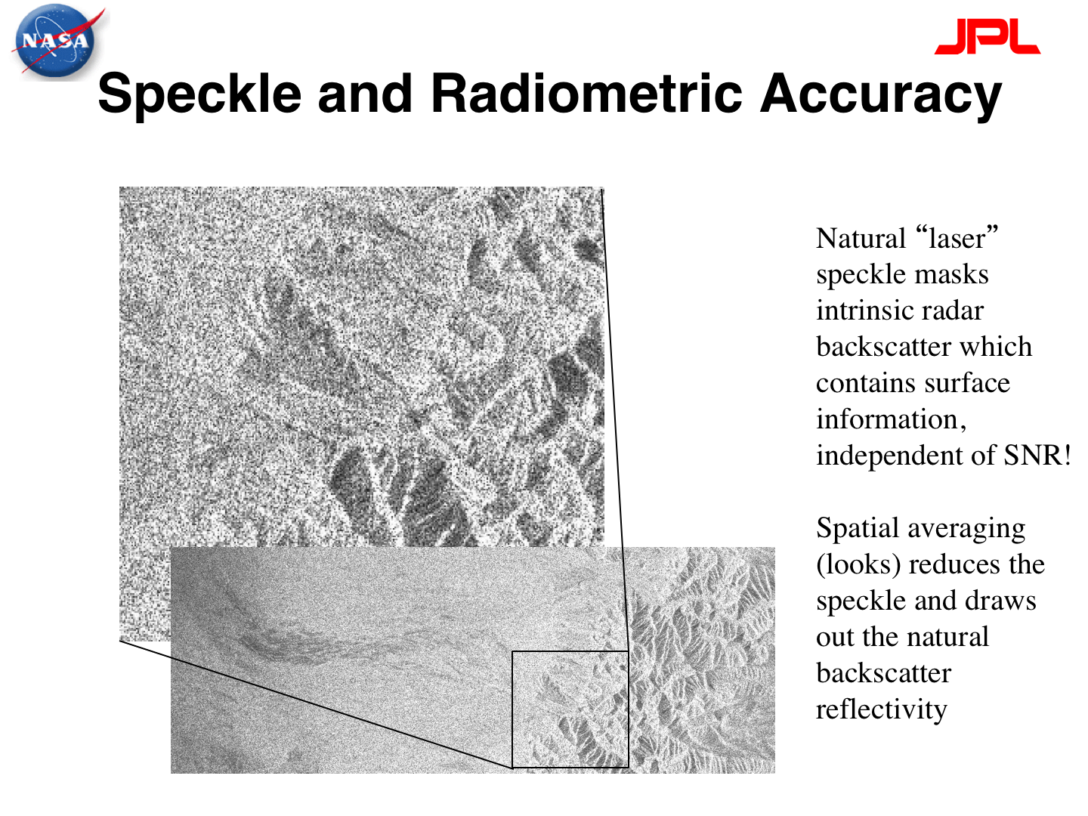

Slide 32
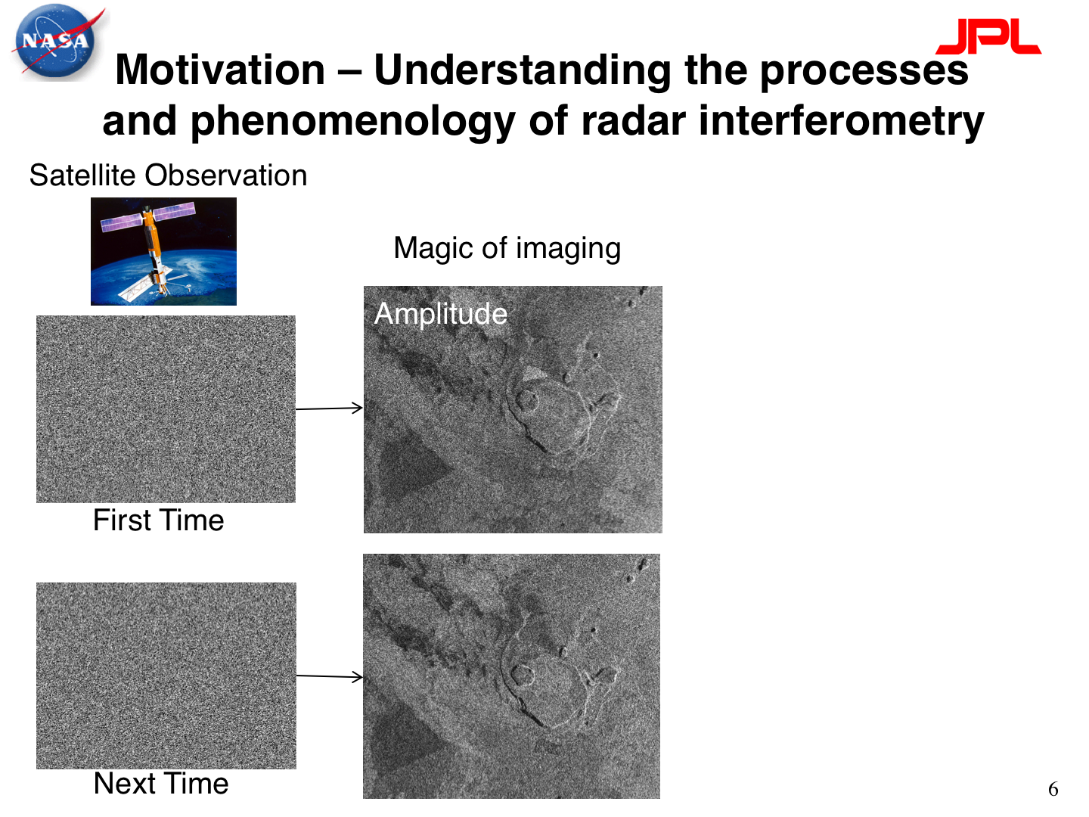

Slide 33
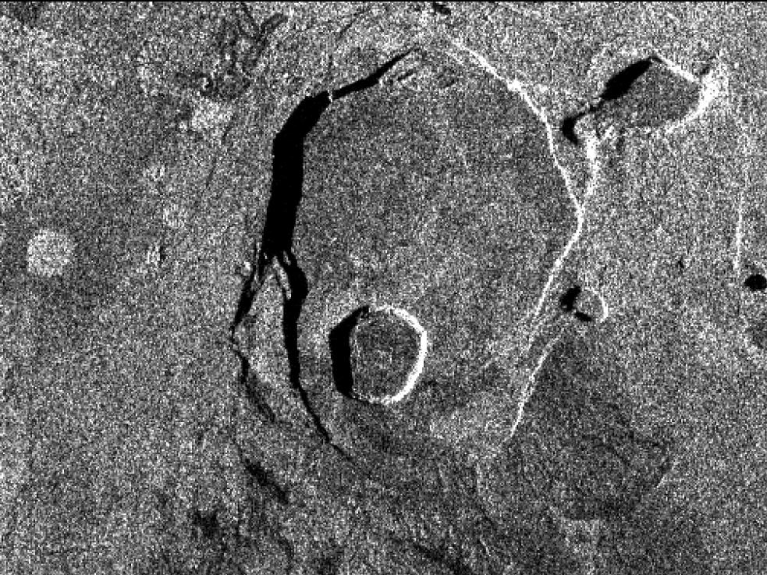
SAR imaging uses amplitude (intensity) of backscattered echoes
Radar sees through clouds—all-weather imaging is possible
Don’t need illumination by the Sun—can image day and night
Surface roughness and slopes control the strength of the backscatter
Applications: ship tracks, ice tracking, oil slicks, land-use changes, planetary
JPL
Notes:
Underneath is a real SAR amplitude image of the caldera of Kilauea volcano in Hawaii. The different shades of gray represent differences in the intensity of backscattered radar from different features on the ground. Bright shades = more backscattered radar returned to the satellite = large amplitude, dark shades = less backscatter making it back to the satellite = small amplitude.
Image source: Underlying SAR image from NASA (public domain) http://photojournal.jpl.nasa.gov/catalog/PIA01763

Slide 34
Kilauea caldera, Hawaii
Flight direction
Look direction
Slopes facing away from satellite show dark backscatter and/or shadowing
Slopes facing toward satellite have bright backscatter
JPL
Notes:
The satellite sensor is set at an angle rather than straight down so all returns but be from type of surface roughness.
If the ground slopes toward the direction in which the satellite is looking (e.g. on the west-facing slopes on the eastern edges of the caldera and various volcanic craters), then the backscatter will be bright—effectively, the sloping ground reflects a lot of the incoming radar waves back to the satellite. Conversely, when the ground slopes away from the satellite, the radar is reflected away from the satellite, and the backscatter intensity measured at the satellite is low. This information can be used to figure out which way the satellite was flying, if you know which way the ground is sloping in your target area.
Image source: Underlying SAR image from NASA (public domain) http://photojournal.jpl.nasa.gov/catalog/PIA01763

Slide 35
Kilauea caldera, Hawaii
Sedimentary drainages are comparatively smooth and have less backscatter
Areas of vegetation are “rough” and have bright backscatter
JPL
Notes:
Away from slopes, differences in backscatter intensity can be attributed to differences in roughness of the ground. Rough ground will scatter radar in many directions, including back toward the satellite—giving a bright backscatter intensity. Smooth ground will act like a mirror and reflect radar away from the satellite, giving a low intensity of backscatter. Here vegetated areas have bright backscatter (trees could potentially scatter radar in many directions), whereas areas where there is sediment deposition appear dark, presumably because the ground surface is smooth. (Still bodies of water, such as lakes, are very effective smooth reflectors of radar and often appear completely dark in SAR amplitude images.)
Image source: Underlying SAR image from NASA (public domain) http://photojournal.jpl.nasa.gov/catalog/PIA01763

Slide 36
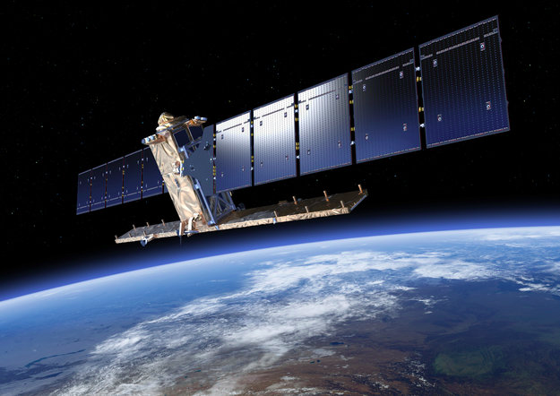
Sentinel
SENTINEL-1A and -1B
European Space Agency
Launch Q2 2014, 2016
12 (and then 6) day repeat in same orbit
mean post event wait => 3 days
ascending + descending => mean wait < 3 days
Notes:
This is the current state-of-the-art: Sentinel-1, a dedicated satellite mission launched by the European Space Agency (ESA) for studying natural hazards. Due to advances in radar instrument design and improvements in the efficiency of solar panels, much more data can be acquired over a wider area on each pass of the satellite, meaning that the repeat interval between image acquisitions can be reduced to just 12 days (compared with 35 days for earlier missions). To further reduce the delay between acquisitions, there will be two satellites in orbit simultaneously, flying six days apart. With two satellites plus ascending and descending coverage, and tight orbital control, we should be able to produce interferograms and earthquake models within a few days of an earthquake, with very little opportunity for decorrelation.
Image source: European Space Agency, public domain. http://www.esa.int/Our_Activities/Observing_the_Earth/Copernicus/Sentinel-1/Facts_and_figures

Slide 37
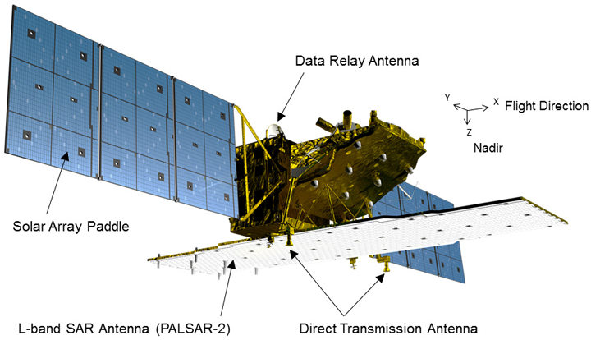
ALOS-2 by Japanese Aerospace Exploration Agency
14-day repeat in same orbit
23 cm wavelength – less decorrelation
Launched Summer 2014
Notes:
Not to be outdone, the Japanese Aerospace Agency (JAXA) has launched a SAR satellite, ALOS-2, that is designed to be effective in vegetated areas. Using a 23 cm wavelength (rather than the ~6 cm wavelength of Sentinel-1), it should be impervious to small changes in vegetation, which is important for imaging deformation in heavily forested Japan.
NASA plans to launch a SAR satellite of its own, with a similar radar wavelength to ALOS-2, in collaboration with the Indian Space Agency (current working project name: NISAR), but the projected launch date is 2020.
Image source: Japanese Aerospace Exploration Agency http://www.eorc.jaxa.jp/ALOS-2/en/about/overview.htm

Slide 38
Interferometric SAR (InSAR) Theory
Interferometric Synthetic Aperture Radar

Slide 39
What about the phase?
Phase is a function of the distance from the satellite to the ground.
ERS-1
~6 cm
~780 km
Notes:
Recall that one wavelength of path length is equivalent to 2π of phase. Given that radar satellites orbit at several hundred km of elevation, it is not feasible to count the number of phase cycles for a single image . . .

Slide 40
InSAR: How it works
Pass 1
Pass 2
Notes:
. . . So what we do is compare (difference) the phase from two different passes of the same satellite over the same point on the ground. Assuming that we can correct for the position of the satellite (and we can), then any difference in phase between the two passes must be related to a change in distance between the satellite and the ground (i.e. a movement of the ground).

Slide 41
InSAR: How it works
Pass 1: pre-movement
Pass 2: post-movement
phase=φ₁
phase=φ₂
phase shift due to ground motion
Notes:
So if the ground moves, we can detect a phase shift when we subtract the phase of the second image from the phase of the first!
It is important to note that we can only measure displacement of the ground toward or away from the satellite, in the line-of-sight direction between the two. Everything we measure is a “line-of-sight” displacement.

Slide 42
InSAR: How it works
phase shift varies with distance from the fault
Notes:
It is important to note that the only way we know that there has been movement of the ground is if different areas on the ground move different amounts—InSAR makes measurements of relative deformation. If the whole area moved by the same amount we would not see any relative phase shift. The cartoon here shows a slipping normal fault, and we would expect that the ground would move farther away from the satellite for an area directly next to the fault than an area farther away. The pattern of relative displacement that we see recorded in the InSAR data is typically diagnostic of the deformation source (e.g. for earthquakes, normal, reverse and strike-slip earthquakes all have different and distinct patterns).

Slide 43
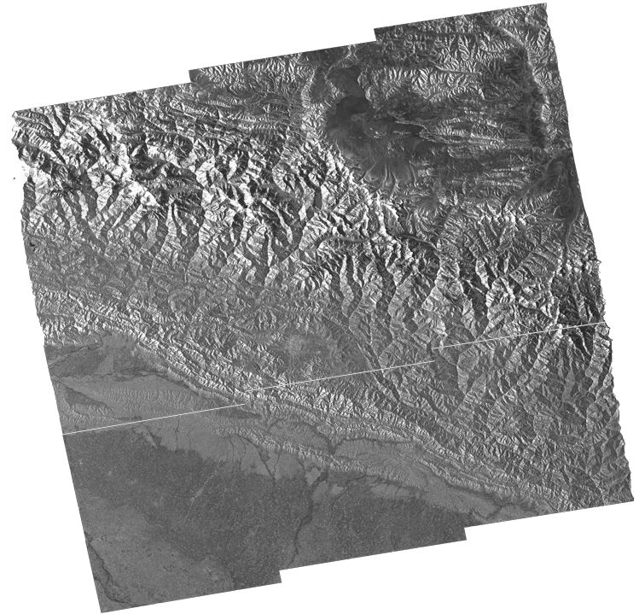
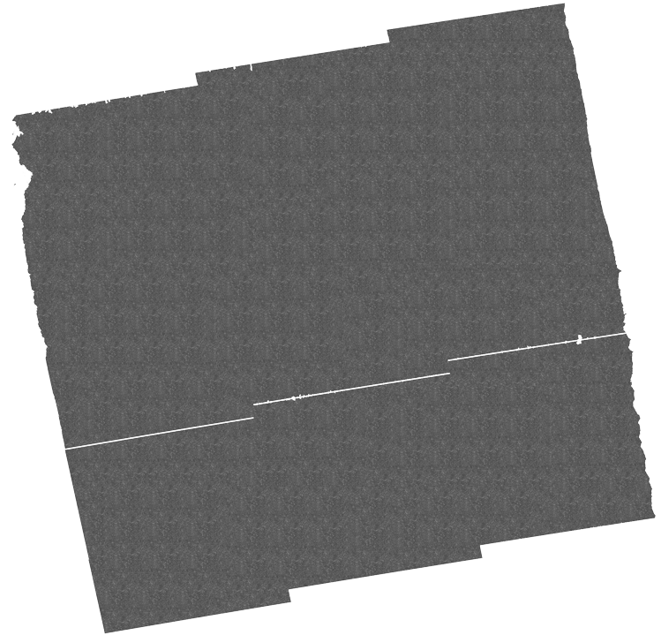
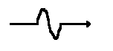
SAR: Synthetic Aperature RADAR
InSAR = Interferometric Synthetic Aperture Radar
v_{flight}
Amplitude (A)
Phase (ɸ)
Synthetic antenna
+
Where we define the distance as:
n whole cycles + a residual phase (ɸ)
Signal is recorded as a complex number:
Z=Ae^{iɸ}
Modified from David Bekaert
Notes:
Resolution is improved from a couple of km to 30 meter

Slide 44
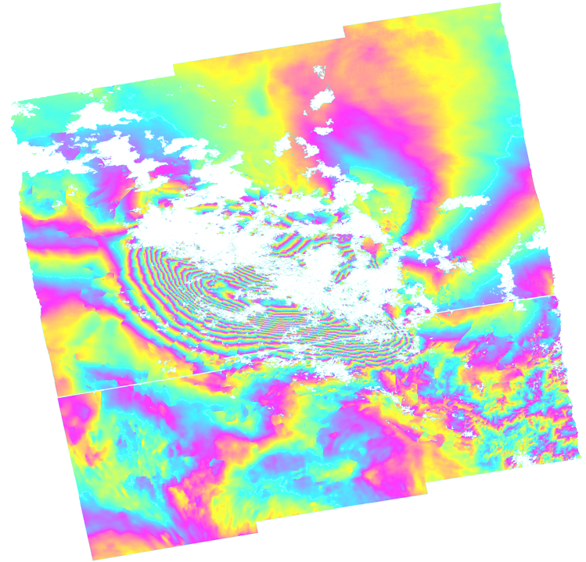
InSAR: Interferometric SAR from differencing two phase images
InSAR = Interferometric Synthetic Aperture Radar
$$φ_{reference}−φ_{secondary}={Δφ}_{interferogram}$$
-
=
Sentinel 1 interferogram by P. Gonzalez
Contains Copernicus data

Slide 45
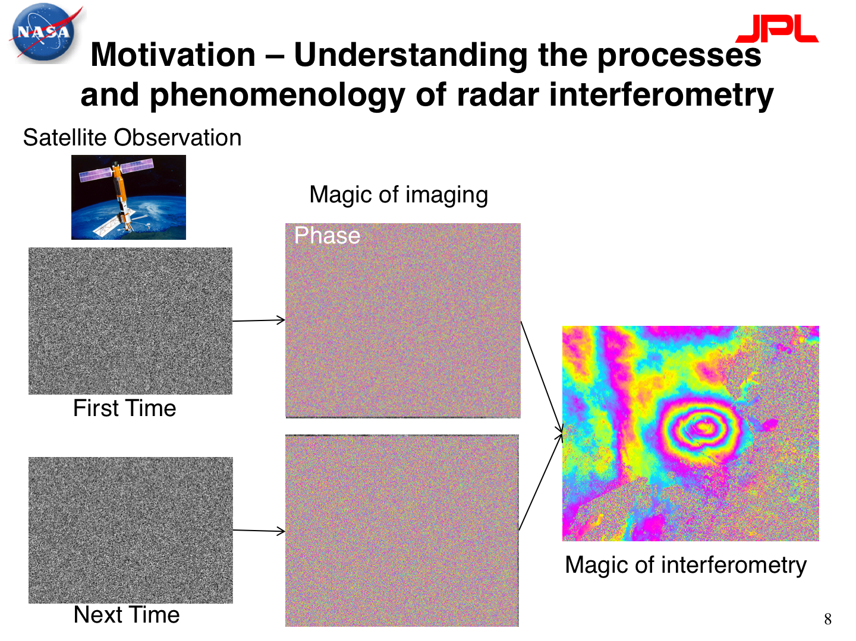

Slide 46
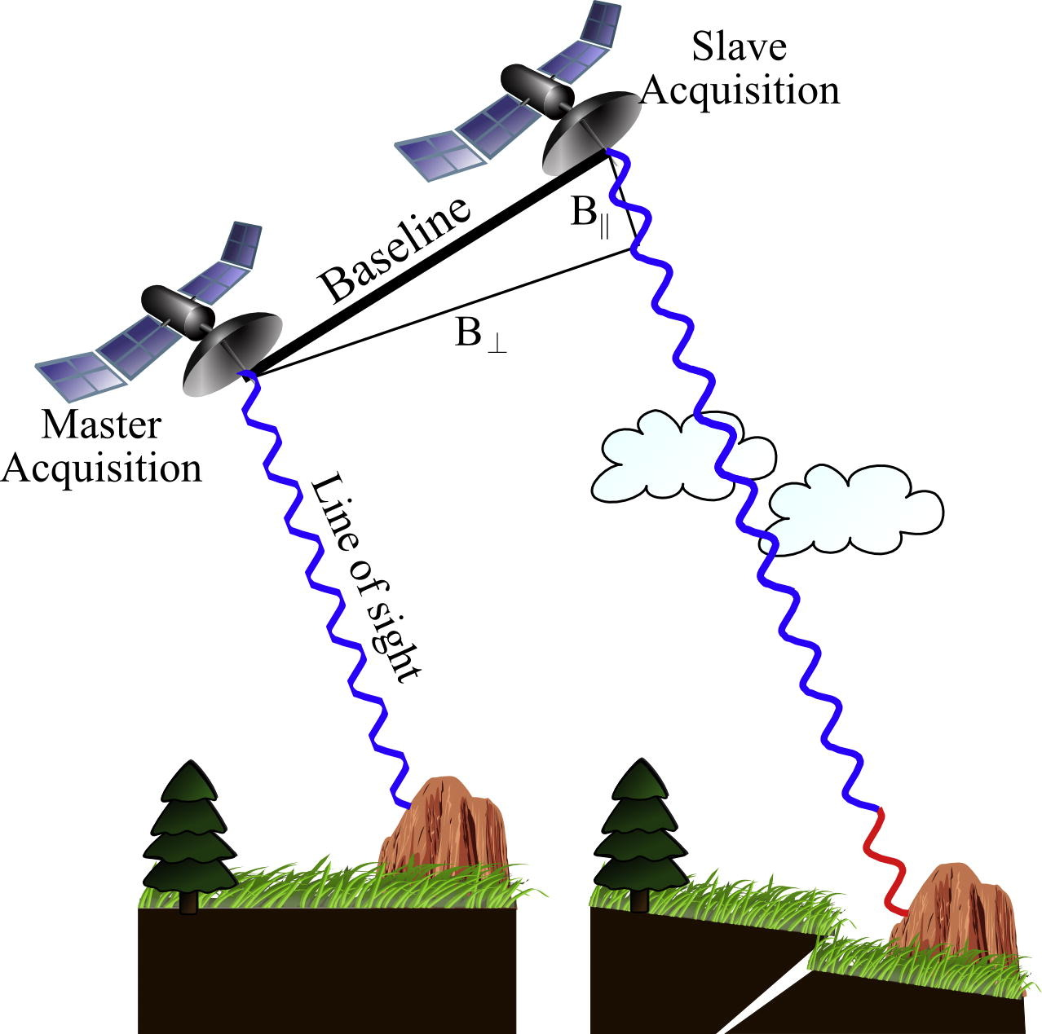
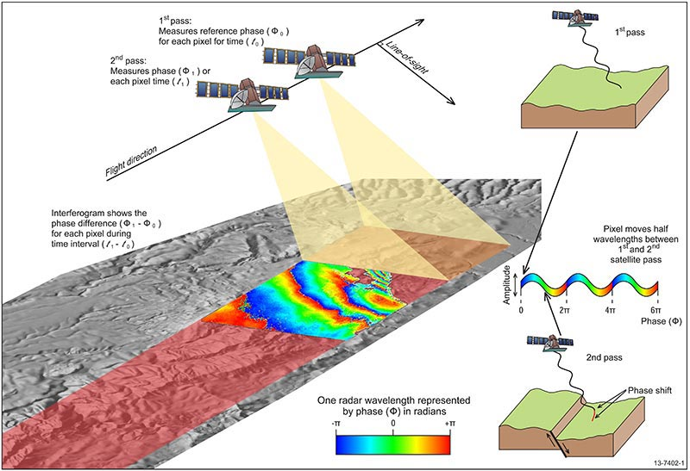
InSAR: Interferometric SAR from differencing two phase images
Osmanoğlu et al., 2016
https://www.ga.gov.au/

Slide 47
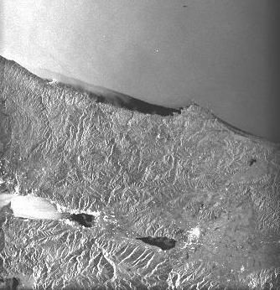

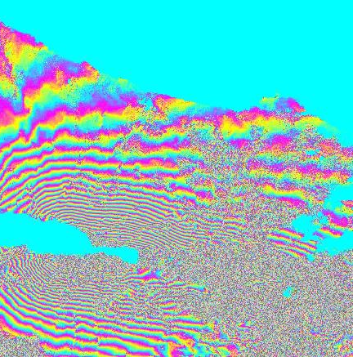

Image A - 12 August 1999
Interferogram = Phase A - Phase B
amplitude
phase
Remove phase from
topography
satellite positions
earth curvature
Image B - 16 September 1999
Tim Wright
Notes:
Here is how we make an InSAR image (we call them “interferograms”).
Two SAR images are shown, amplitudes on the left, phases on the right. They are both from the same area of Turkey, acquired five weeks apart in the summer of 1999.
The amplitude images are used to match and align the two SAR images to each other, to make sure that when you difference the phase, you are differencing the phase for the “same” pixels. The various corrections that are made to the phase rely on having accurate information on the satellite orbits and topography of the area being imaged; however, such corrections are standard during processing, the orbits are closely monitored from the ground (the satellites also often carry dedicated instruments for the purpose), and projects such as the Shuttle Radar Topography Mission (SRTM) project have produced global digital elevation models that can be used to correct for topography.
Image source: Tim Wright (University of Leeds) – used with permission
Learn more about the analysis described here from: Wright, T. J., Parsons, B. E., Jackson, J. A., Haynes, M., Fielding, E. J., England, P. C. and Clarke, P. J. (1999) Source parameters of the 1 October 1995 Dinar (Turkey) earthquake from SAR interferometry and seismic bodywave modelling, Earth Planet. Sci. Lett., 172, 23-37. http://www.sciencedirect.com/science/article/pii/S0012821X99001867

Slide 48
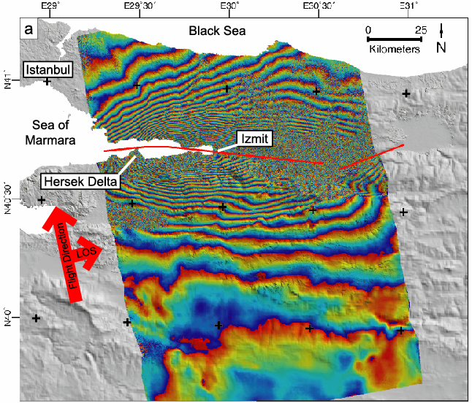
(-20) 567 mm range decrease
(-10) 283 mm range decrease
(-2) 57 mm range decrease
(-1) 28 mm range decrease
(0) 0 mm range change
17 August 1999, Izmit earthquake (Turkey)
Tim Wright
Notes:
How to interpret an interferogram? To begin we have to be sure of the sign convention of the deformation signal. Here each colored “fringe” from blue to yellow to red represents a movement of the ground toward the satellite of 28.3 mm in the line-of-sight direction (this is often described as a decrease in the range—that is to say, the distance—between the satellite and the ground).
If we assume that the color boundary between red and blue farthest to the south represents zero deformation (say), then each successive fringe cycle from blue-yellow-red represents an increasing movement of the ground toward the satellite of 28.3 mm, just like contours of elevation on a topographic map.
The first fringe to the north of our zero fringe indicates a movement of 28.3 mm toward the satellite.
The second fringe to the north of our zero fringe indicates a movement of 56.6 mm toward the satellite.
The tenth fringe to the north of our zero fringe indicates a movement of 283 mm toward the satellite.
The 20th fringe to the north of our zero fringe indicates a movement of 566 mm towards the satellite.
And so on . . .
Given that the satellite was flying from south to north and looking to the east, the reductions in distance between satellite and ground are consistent with westward motion of the ground south of the fault.
Image source: Tim Wright (University of Leeds) – used with permission

Slide 49
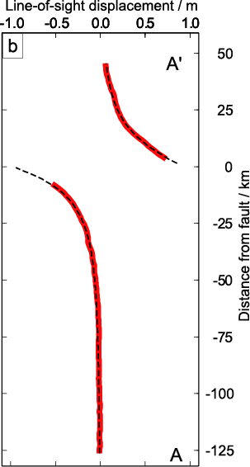
A’
A
17 August 1999, Izmit earthquake (Turkey)
Tim Wright
Notes:
If you plot a profile of the cumulative displacement represented by the fringes, you get a curve that looks something like this. Note that there is a discontinuity in the pattern in the center, around the city of Izmit; you have to repeat the analysis of the northern part of the deformation pattern separately, counting in from the edge of the deformation pattern like before. The shape of the curve is consistent with the expected elastic rebound from a strike-slip earthquake. The 1.2 m of line-of-sight displacement measured here corresponds to approximately 3.5 m of right-lateral offset.
Image source: Tim Wright (University of Leeds) – used with permission

Slide 50
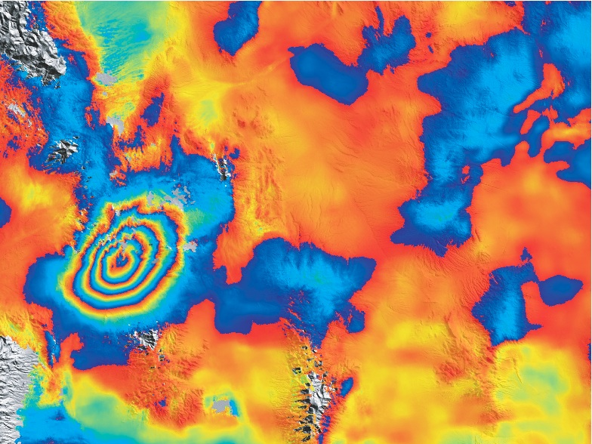
2008 Wells, Nevada
Each cycle of
blue => yellow => red
= 28 mm of displacement
(half of the radar wavelength)
away from the satellite
10 km
Notes:
Here is another earthquake interferogram, from the 2008 Wells, Nevada earthquake. In this case, each cycle of blue to yellow to red represents an increase in distance (a range increase) of 28 mm between the satellite and the ground. [Note that there is no standard convention for the color scheme of interferograms!]
The earthquake is represented by four concentric fringes. The whole pattern is about 10 km long and 8 km wide. Assuming that all of the line-of-sight deformation in this case represents vertical deformation, the four fringes represent a maximum of about 12 cm of subsidence of the surface, at the center of the pattern. One way of visualizing this is to imagine it raining after the earthquake. If the depression caused by the earthquake filled in with water, you would have a puddle 10 km long by 8 km wide, and 12 cm deep in the middle. If you visited the area after the earthquake, what are the chances you would recognize that as being the signature of an earthquake on the ground? → there would most likely NOT be any evidence from the surface because it is 10-12cm of change across 10 km wide area
Was there a surface rupture?
→ No. We can not see any discontinuities that are associated with with quake so no surface rupture

Slide 51
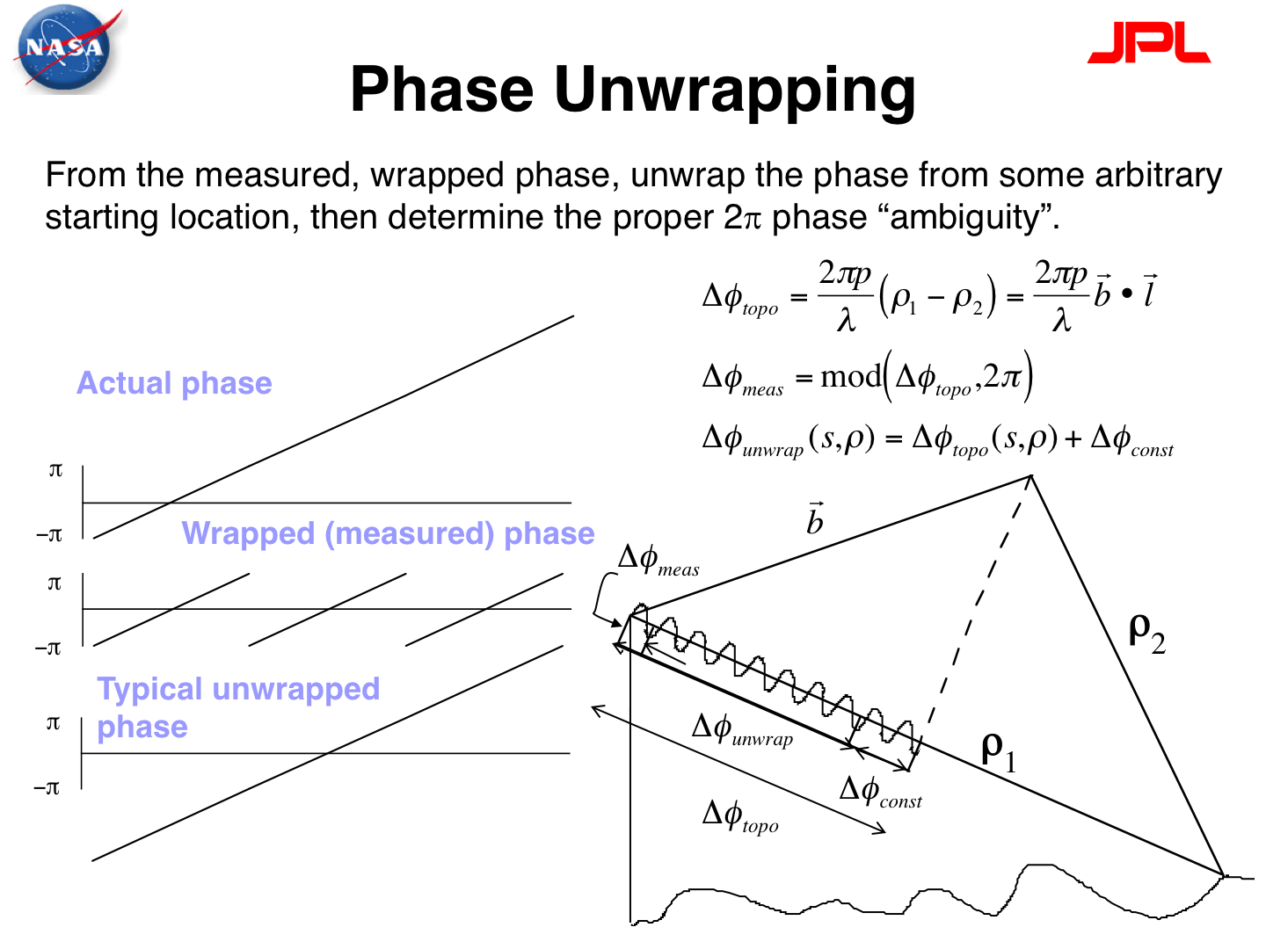

Slide 52
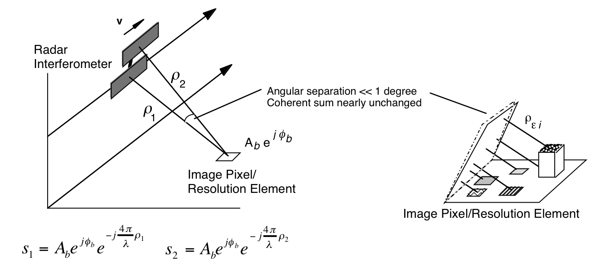

Slide 53
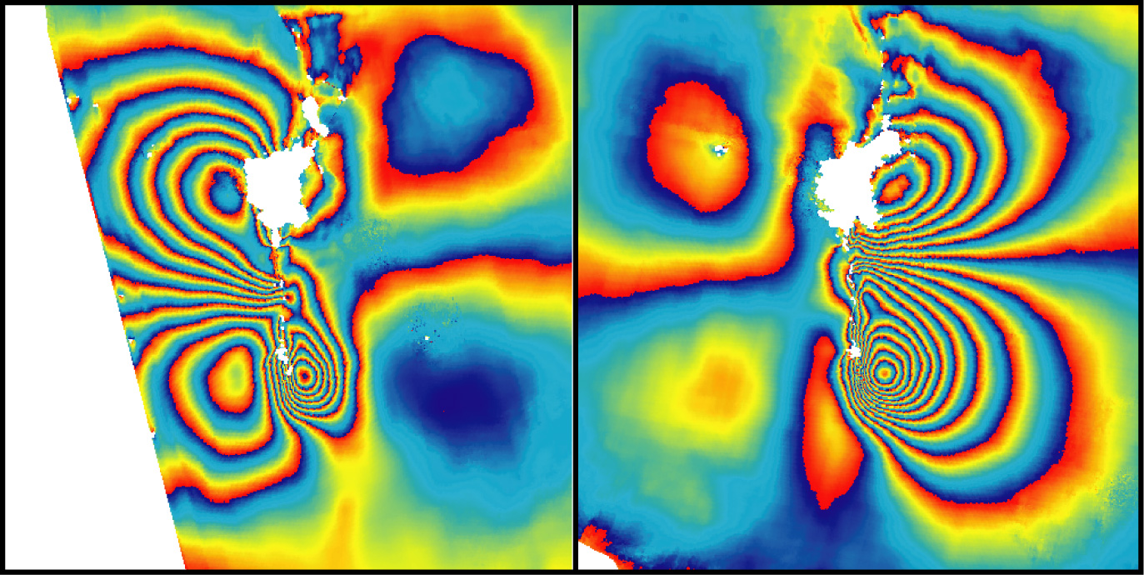
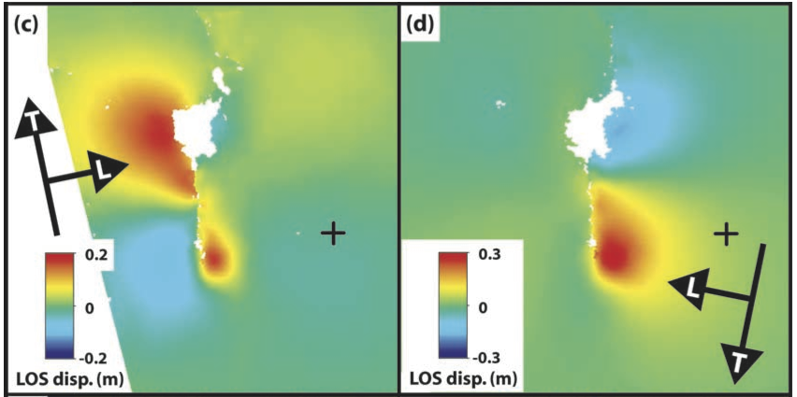
“wrapped”
“unwrapped”
Notes:
Here is an interferogram of a strike-slip earthquake (Bam, Iran, 2003), presented two different ways. On the left is the “wrapped” interferogram, which is the form we have seen several times already, with multiple fringes defining the deformation pattern (here blue-yellow-red is a motion toward the satellite of 28 mm). On the right is an “unwrapped” interferogram where the displacements associated with each fringe have been added together to give the total displacement—these are typically easier to interpret than the wrapped interferograms (again, here, red indicates movement toward the satellite, blue indicates movement away from the satellite).
Image source: G J Funning, B Parsons, T J Wright, J A Jackson and E J Fielding, 2005, Surface displacements and source parameters of the 2003 Bam, Iran earthquake from Envisat Advanced Synthetic Aperture Radar imagery, J. Geophys. Res., 110 (B9), B09406, doi:10.1029/2004JB003338.
http://earthsciences.ucr.edu/docs/funning_etal_2005_jgr_bam_earthquake.pdf
American Geophysical Union allows reuse of an image from a journal article for educational noncommercial purposes. Copyright is retained by AGU.
http://publications.agu.org/author-resource-center/usage-permissions/

Slide 54
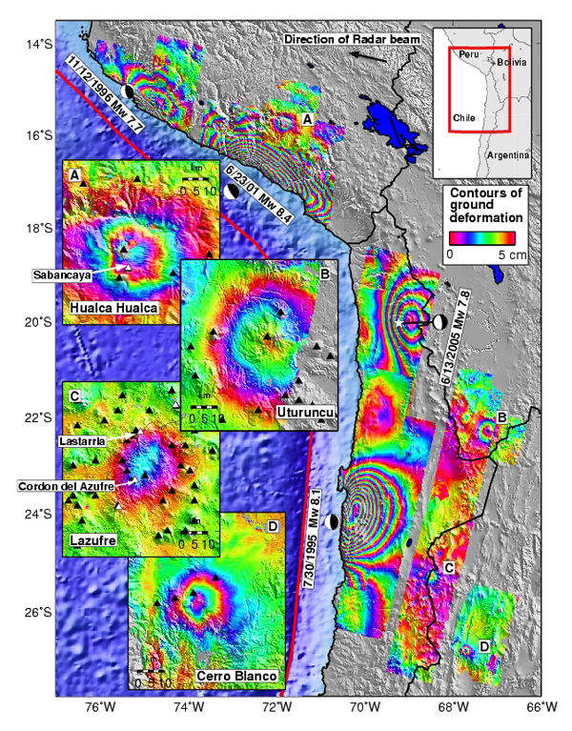
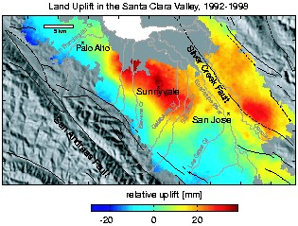
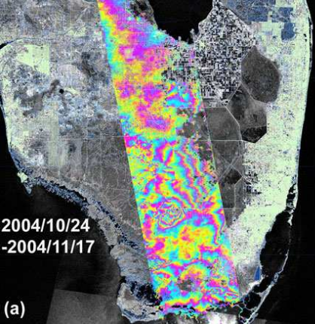
Schmidt and Burgmann (2003)
Pritchard and Simons (2004)
Wdowinski et al (2006)
Notes:
Some other applications of InSAR. On the left is a map of the western margin of South America (Peru and Chile) showing four major subduction zone earthquakes, plus the deformation associated with four active volcanoes in the Andes (some moving up, some moving down, depending on the details of the magmatic systems feeding the volcanoes).
Top right shows the cumulative displacement from analysis of multiple interferograms covering the Santa Clara Valley (northwest of San Jose in northern California) over a six-year period showing that the center of the valley rose by approximately 40 mm over that time, attributed to recharge of a major groundwater aquifer in the valley.
Bottom right shows the difference in water levels within the Everglades in south Florida between two dates in Fall 2004.
Image sources (clockwise from left):
Pritchard, M. E. and M. Simons (2004) Surveying volcanic arcs with satellite radar interferometry: The central Andes, Kamchatka, and beyond. GSA Today 14, 4-10. http://www.geo.cornell.edu/eas/PeoplePlaces/Faculty/matt/gsatv14n8_science.pdf Geological Society of America allows reuse of a single figure from an article for education noncommerical purposes. Copyright is retained by GSA. http://www.geosociety.org/pubs/copyrt.htm
Schmidt, D. and R. Bürgmann (2003) Time-dependent land uplift and subsidence in the Santa Clara valley, California, from a large interferometric synthetic aperture radar data set. Journal of Geophyical Research Solid Earth, 108, B9, DOI: 10.1029/2002JB002267. http://onlinelibrary.wiley.com/doi/10.1029/2002JB002267/epdf American Geophysical Union allows reuse of an image from a journal article for educational noncommercial purposes. Copyright is retained by AGU. http://publications.agu.org/author-resource-center/usage-permissions/
Wdowinski, S., S. Kim, F. Amelung, and T. Dixon (2006) Wetland InSAR: A new space-based hydrological monitoring tool of wetlands surface water level changes, GlobWetland Symposium proceedings. https://www.rsmas.miami.edu/users/swdowinski/publications/Wdowinski-GlobWetlands-proceedings.pdf GlobWetlands Symposium is part of the open CGIAR. https://cgspace.cgiar.org/

